Slide 1


NON-WSQ COURSE · C1373
Version v2.0 · 9 November 2026
Generative AI for Video Creation
Made entirely in Higgsfield: Supercomputer · Cinema Studio · Seedance 2.5 · Elements · Draft mode
Tertiary Infotech Academy Pte Ltd
UEN 201200696W
© 2026 Tertiary Infotech Academy Pte Ltd. All rights reserved. | www.tertiarycourses.com.sg | enquiry@tertiaryinfotech.com | +65 6100 0613

Slide 2
COURSE ADMINISTRATION
Welcome & Housekeeping
© Tertiary Infotech Academy Pte Ltd
Generative AI for Video Creation · C1373
2

Slide 3
YOUR TRAINER · GENERAL
About the Trainer
NAME
____________________________________________
?
TITLE / DESIGNATION
____________________________________________
QUALIFICATIONS
____________________________________________
Your Trainer
AREAS OF EXPERTISE
____________________________________________
General Trainer template —
to be completed by the trainer
TRAINING & INDUSTRY EXPERIENCE
____________________________________________
CONTACT
____________________________________________
© Tertiary Infotech Academy Pte Ltd
Generative AI for Video Creation · C1373
3

Slide 4
YOUR TRAINER
About the Trainer
CURRENT ROLES
Producer at Asia Media Alliance (2024–present); Director at Asia Media Academy (2020–present).
TH
FILM & TV TRACK RECORD
Team Lead, Camokakis Content (Digital) and Senior Commissioning Editor at So Drama! Entertainment; Executive Producer at Stardust Pictures; VP Physical Productions at Infinite Frameworks Studios.
Mr Tay Hoo Wee
QUALIFICATIONS
BA (Hons) Digital Film Making, Middlesex University; Diploma in Digital Film Production, SAE Institute Singapore.
Producer, Asia Media Alliance
Director, Asia Media Academy
CONTACT
linkedin.com/in/hoowee
© Tertiary Infotech Academy Pte Ltd
Generative AI for Video Creation · C1373
4

Slide 5
ICE-BREAKER
Let's Know Each Other
Your name and organisation / role.
Your experience with video creation or editing (if any).
1
2
What videos do you want to create after this course — marketing, training, social media?
3
© Tertiary Infotech Academy Pte Ltd
Generative AI for Video Creation · C1373
5

Slide 6
HOUSEKEEPING
Ground Rules
Set your mobile phone to silent mode.
Participate actively — no question is too small.
1
2
Respect each other's views.
One conversation at a time.
3
4
Exit quietly for calls or breaks.
Be punctual and attend both days to get the most from the course.
5
6
© Tertiary Infotech Academy Pte Ltd
Generative AI for Video Creation · C1373
6

Slide 7

COURSE PORTAL
Login to LMS and Download Course Material
Log in at lms-tms.tertiaryinfotech.com with your registered email and the OTP sent to your inbox, then open this course to download the slides and Learner Guide.
© Tertiary Infotech Academy Pte Ltd
Generative AI for Video Creation · C1373
7

Slide 8
SCHEDULE · 9:30AM–5:30PM · 15 HOURS
Lesson Plan — 2 Days, 7.5 hours/day
Day 1 · 9:30–13:45 · Topic 1 (3 h 45 min)
Introductions and Higgsfield sign-up; the impact of AI on video and its use cases; Labs 1–3.
Day 1 · 13:45–17:30 · Topic 2
Elements: characters, locations, props (Lab 4); shots and takes in Cinema Studio (Lab 5); Day 1 recap.
1
2
Day 2 · 9:30–10:45 · Topic 2 (5 h in total)
Cut, caption and assess the scene (Lab 6).
Day 2 · 10:45–17:30 · Topic 3 (6 h 15 min)
Fix, voice, music and effects (Labs 7–8); use-case sprint (Lab 9); mini capstone (Lab 10); ethics of GenAI video.
3
4
Day 2 · 17:10–17:30 · close of Topic 3
Course summary, questions and the course feedback survey.
Lunch · 30 minutes each day
Day 1 12:45–13:15 · Day 2 12:30–13:00. Refreshments are taken during activity time.
5
6
© Tertiary Infotech Academy Pte Ltd
Generative AI for Video Creation · C1373
8

Slide 9
THREE TOPICS · TEN HANDS-ON LABS · ONE STUDIO: HIGGSFIELD
Course Outline
Topic 1 — Create and Edit Video Script Using Generative AI (GAI)
Script, plan and make your first video: Higgsfield sign-up, Supercomputer and AI Director scripts and shot lists, standards, work plan and credit budget. (Labs 1–3)
1
Topic 2 — Improve Video Footage on GAI Powered Video Platforms
Build, shoot and assess: Elements (characters, locations, props), references, Cinema Studio shots and takes, Draft mode, cut, captions and quality scoring. (Labs 4–6)
2
Topic 3 — Apply new AI technologies to Improve Video Production
Fix, finish and publish: replace objects, upscale, reframe, voice, music, effects, model comparison, a published ad and your own mini capstone video. (Labs 7–10)
3
© Tertiary Infotech Academy Pte Ltd
Generative AI for Video Creation · C1373
9

Slide 10
TOPIC 1
1
Lab 1 — Sign Up and Make Your First 15-Second Video
Create and Edit Video Script Using Generative AI (GAI)
2
Lab 2 — Write the Script and Shot List with Supercomputer and AI Director
3
Lab 3 — Set the House Rules: Standards, Work Plan and Credit Budget
The impact of AI on video · use cases · Supercomputer scripts · AI Director shot lists · standards & work plans
© Tertiary Infotech Academy Pte Ltd
Generative AI for Video Creation · C1373
10

Slide 11
KEY CONCEPTS
Key Concepts — Topic 1
AI's impact & use cases
A US$2,000 TV ad, a 14-day feature: AI movies, micro dramas, influencers, singers and marketing videos already earn audiences.
The lazy prompt
Format + vibe gets you a clip in one line, but the model then decides your character, world and camera.
1
2
Scripts with Supercomputer
Who / where / what happens, then a script and a numbered shot list, drafted and refined in one chat.
AI Director
Inside a project, AI Director writes the script and a shot-by-shot storyboard from your brief (Lab 2 asks for six shots).
3
4
Standards & guidelines
A one-page sheet: platform specs, consent, licensing, AI disclosure and a Draft-first credit rule.
Work plans & credit budgets
Phases, owners, timelines and a credit budget: 45 credits for a 15 s Draft, 240 for the 1080p final.
5
6
© Tertiary Infotech Academy Pte Ltd
Generative AI for Video Creation · C1373
11

Slide 12
WHAT YOU'LL DO
Hands-On Labs — Topic 1
Lab 1 — Sign Up and Make Your First 15-Second Video
Two 15-second Draft clips of the same idea, plus a log of what the model decided and three quality issues you spotted.
1
Lab 2 — Write the Script and Shot List with Supercomputer and AI Director
A reviewed 15-second script and a 6-shot shot list in the three-part prompt format, saved in your project brief.
2
Lab 3 — Set the House Rules: Standards, Work Plan and Credit Budget
A one-page standards & guidelines sheet, a phased work plan with timelines and a credit budget, and your own /house-standards skill.
3
© Tertiary Infotech Academy Pte Ltd
Generative AI for Video Creation · C1373
12

Slide 13

WHY THIS COURSE
Two 15-second films. Two prompts. Zero cameras.
Both clips on the next slides were made for this course in Higgsfield with Seedance 2.5, one prompt each, sound included. By the end of Day 2 you will direct your own.
© Tertiary Infotech Academy Pte Ltd
Generative AI for Video Creation · C1373
13
Notes:
Image: generated with Higgsfield GPT Image 2.6 (medium, 1K, 0.5 credits). Prompt: modern video creator's desk at night, laptop with an editing timeline, storyboard notebook, terracotta lamp light, no text or logos.

Slide 14
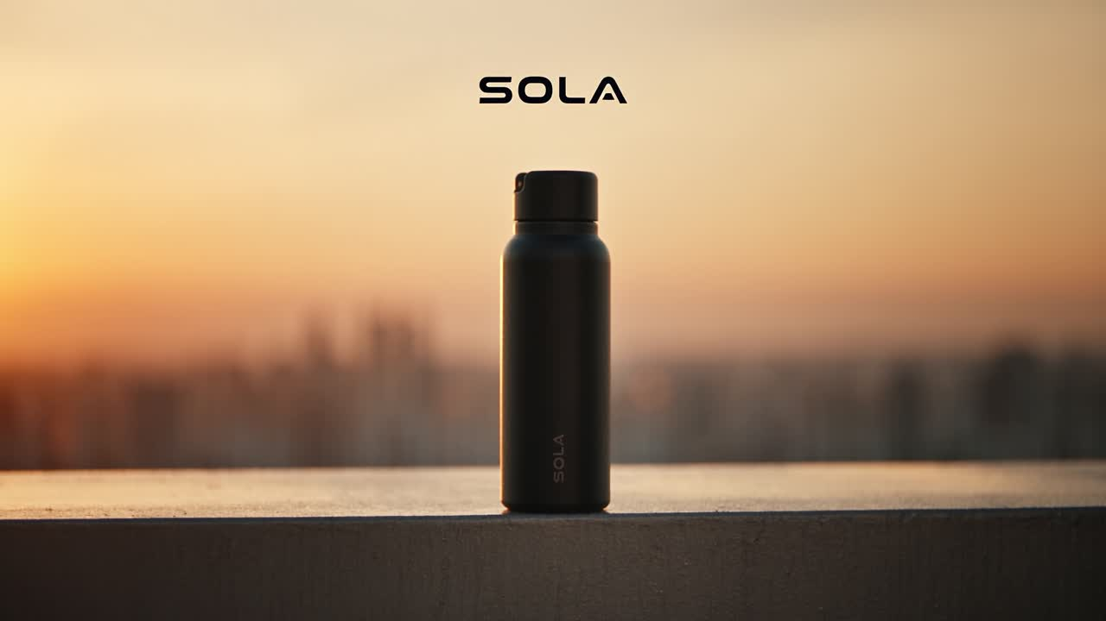
MADE IN HIGGSFIELD · AI MARKETING
SOLA: a 15-second product ad
A product ad with a hero packshot, written as five timed shots
THE SHOTS WE PROMPTED
0–3 s
extreme close-up, sun slides across the bottle
3–6 s
runner grabs it mid-stride (tracking)
6–9 s
drink, ice clinks (slow motion)
9–12 s
wide rooftop run, drone pulls back
12–15 s
hero packshot with space for the logo
▶ Click to play · Seedance 2.5 · 1080p · 16:9 · 15 s · native audio · 240 credits
© Tertiary Infotech Academy Pte Ltd
Generative AI for Video Creation · C1373
14
Notes:
Play it with sound. Point out: the bottle stays the same in every shot because the prompt names it in every shot; the beat hits on the packshot because the Sound line asked for it. Cost: 240 credits at 1080p; the same take as a 480p Draft costs 45.

Slide 15

MADE IN HIGGSFIELD · AI SCI-FI
Ringfall: a 15-second epic sci-fi scene
An epic scene with an establishing shot, a reveal and a payoff
THE SHOTS WE PROMPTED
0–4 s
wide: smoking starship wreck, twin suns
4–8 s
pilot steps out, handheld follow
8–11 s
close-up: awe, ground trembles
11–15 s
extreme wide: the ring rises, crane up
▶ Click to play · Seedance 2.5 · 1080p · 16:9 · 15 s · native audio · 240 credits
© Tertiary Infotech Academy Pte Ltd
Generative AI for Video Creation · C1373
15
Notes:
Ask learners which shot sells the scale (the extreme wide at 11–15 s) and why the close-up comes before it (we see her awe before we see what she sees).

Slide 16
THE PROCESS YOU'LL RUN — EVERY LAB MAPS TO A STAGE
The Higgsfield Video Pipeline
1
2
3
4
5
Script & Shot List
Elements
Shots & Takes
Fix & Finish
Publish
Supercomputer · AI Director
characters · locations · props
Cinema Studio · Seedance 2.5
replace · upscale · voice · music
9:16 + 16:9 · TikTok · YouTube
ONE PLATFORM, FIVE STAGES
You script and plan in Supercomputer (Topic 1), build Elements and direct takes in Cinema Studio (Topic 2), then fix, finish and publish (Topic 3).
© Tertiary Infotech Academy Pte Ltd
Generative AI for Video Creation · C1373
16

Slide 17
TOPIC 1 · THE IMPACT OF AI ON VIDEO CREATION
AI has changed the economics of video
Budgets, crews and timelines that used to decide who could make video no longer do
US$2K
14 days
45
a national TV ad
Kalshi's NBA Finals spot: about US$2,000 and 15 clips cut from 300–400 generations (The Keyword)
a 95-minute feature
Hell Grind: 15 people, under US$500K (CineD)
credits a test take
one 15-second Seedance 2.5 Draft in Higgsfield, before you commit to 1080p
The new bottleneck is direction: knowing what to ask for, judging the take, and fixing what fails. That is this course.
© Tertiary Infotech Academy Pte Ltd
Generative AI for Video Creation · C1373
17
Notes:
Sources on slide. Kalshi's view counts (30M+/100M) are the creator's own claims, so quote the cost and the airing.

Slide 18
TOPIC 1 · BEFORE AND AFTER
What AI changes at each stage of production
Stage
Before AI
With AI (in Higgsfield)
Script & storyboard
Writer + storyboard artist, days
Supercomputer / AI Director, minutes; you review and edit
Casting & locations
Auditions, permits, travel
Elements: cast, sets and props generated and saved
The shoot
Crew, camera, lights, a day per scene
Cinema Studio takes: camera, lens, light set in the prompt
Fixes & reshoots
Re-book cast and crew
Replace an object, regenerate one shot, upscale
Sound & music
Composer, voice artist, studio
Native audio, generated soundtrack, consented voice
New risks
—
Likeness, rights, disclosure, quality drift: the platform rules apply
TIP: Ask: which of these jobs disappears, and which becomes more valuable? (Direction, review, compliance.)
© Tertiary Infotech Academy Pte Ltd
Generative AI for Video Creation · C1373
18

Slide 19
TOPIC 1 · USE CASES
Five ways AI video already earns audiences
AI movie
Hell Grind: a 95-minute Higgsfield feature, 15 people, 14 days (CineD).
AI micro drama
Kling's Mountains & Seas premiered on Kuaishou on 13 Jul 2024: 52M+ views (Caixin).
1
2
AI influencer
Aitana López, an AI model, earns up to €10,000 a month (Euronews).
AI singer
Xania Monet: first AI act on a Billboard radio chart, No. 30 Adult R&B Airplay (Nov 2025).
3
4
AI marketing
Kalshi's NBA Finals ad: about US$2,000, made with Google Veo 3 (The Keyword).
Your turn
Lab 9 ends with your own 15-second ad, published or uploaded to the TMS.
5
6
© Tertiary Infotech Academy Pte Ltd
Generative AI for Video Creation · C1373
19

Slide 20

USE CASE 1 · AI MOVIE
AI movies: cinema-grade scenes from a prompt
Long-form stories need what Topic 2 teaches: Elements that keep every face and set consistent
◀ CLICK TO PLAY · THE FILM
The Most Insane AI Film You'll See Today (Seedance 2.5)
Video: Theoretically Media. A short film made with Seedance 2.5, the model you will use in Labs 1–9.
ALSO IN THE NEWS
Hell Grind — Higgsfield Originals (2026)
95 minutes, under US$500K, 15 people, 14 days (CineD). Billed by Higgsfield as the first AI feature film.
▶ Open in YouTube
© Tertiary Infotech Academy Pte Ltd
Generative AI for Video Creation · C1373
20
Notes:
To play: in PowerPoint click Enable Content on the yellow security bar first (online video is blocked until you do), be online, then in Slide Show click the video. If it still will not play, use the Open in YouTube link. Slide Show: click the video to play (internet needed; click Enable Content on the yellow bar first). Hell Grind did not screen in the official Cannes programme; say so if asked.

Slide 21

USE CASE 2 · AI MICRO DRAMA
AI micro dramas: one-minute episodes, no film set
Short, serial, vertical stories: the format Lab 9's variation prompt practises
◀ CLICK TO PLAY · THE SHORT
The Healer's Refusal — an AI-generated Chinese micro drama
A vertical, cliff-hanger episode made entirely with AI: the format built for TikTok and YouTube Shorts.
ALSO IN THE NEWS
Mountains & Seas: Breaking Waves — Kling AI
Kuaishou's AI micro drama premiered 13 Jul 2024 and passed 52M views (Caixin).
WHAT IT MEANS FOR YOU
Two characters, one twist, 9:16. Save the cast as Elements so episode 2 looks like episode 1.
▶ Open in YouTube
© Tertiary Infotech Academy Pte Ltd
Generative AI for Video Creation · C1373
21

Slide 22

USE CASE 3 · AI INFLUENCER
AI influencers: one face, posting every day
Higgsfield's AI Influencer tool and a saved @char Element make the same face repeatable
◀ CLICK TO PLAY · THE SHORT
Creating an AI influencer with Higgsfield AI Influencer Studio
A creator builds a consistent virtual influencer inside Higgsfield (Shafin Tech).
ALSO IN THE NEWS
Aitana López — BBC World Service report
An AI model earning up to €10,000 a month, about €3,000 on average (Euronews).
WHAT IT MEANS FOR YOU
Consistency is the product: a character sheet plus an @char Element. Disclose that the person is synthetic.
▶ Open in YouTube
© Tertiary Infotech Academy Pte Ltd
Generative AI for Video Creation · C1373
22
Notes:
Link to the platform rules: TikTok and YouTube both ask creators to label realistic AI content.

Slide 23

USE CASE 4 · AI SINGER
AI singers: a voice, a song, a music video
Music video, voice and soundtrack: Lab 8 gives you all three inside Higgsfield
◀ CLICK TO PLAY · THE SHORT
Pretty Little Baby — an AI cover (Ai Music Sunny)
An AI singer covering Connie Francis's song: a fast-growing Shorts genre, and a live rights question.
ALSO IN THE NEWS
Xania Monet — How Was I Supposed to Know?
First AI act on a Billboard radio chart: No. 30 on Adult R&B Airplay (Billboard, Nov 2025). Music made with Suno.
WHAT IT MEANS FOR YOU
Covering someone else's song or voice needs the rights holder's permission. Original music and your own voice are safe ground.
▶ Open in YouTube
© Tertiary Infotech Academy Pte Ltd
Generative AI for Video Creation · C1373
23
Notes:
Discussion: is an AI cover of a real artist's song publishable? Who owns the voice? Tie to the Lab 8 consent form.

Slide 24

USE CASE 5 · AI MARKETING
AI marketing: studio-quality ads in minutes
The use case you will run end to end in Lab 9: one product photo to a published ad
◀ CLICK TO PLAY · THE SHORT
Higgsfield Marketing Studio — UGC ads in seconds
A creator makes UGC-style product ads in Higgsfield's Marketing Studio (AI Tech Pro).
ALSO IN THE NEWS
Kalshi NBA Finals ad — PJ Ace (2025)
About US$2,000; 300–400 generations cut to 15 clips with Google Veo 3; aired in Game 3 of the NBA Finals (The Keyword).
WHAT IT MEANS FOR YOU
Start from a clean product photo, keep the product identical in every shot, label the ad as AI-generated.
▶ Open in YouTube
© Tertiary Infotech Academy Pte Ltd
Generative AI for Video Creation · C1373
24
Notes:
The SOLA ad in the Big Picture section was made the same way: one prompt, five shots, 240 credits at 1080p.

Slide 25
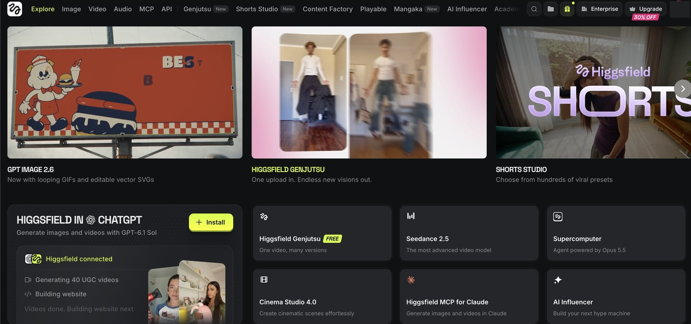
HIGGSFIELD.AI · THE HOME PAGE
Every tool you need sits on one home page
Learn five tiles today and you can find everything else from them
4
2
1
3
5
1
Supercomputer
2
Seedance 2.5
3
Cinema Studio 4.0
4
Genjutsu
5
Higgsfield in Claude & ChatGPT
The agent: brief it in plain English, it plans, prompts and asks before it spends.
ByteDance's video model: 4–30 s, up to 1080p, native sound, 50 references.
The director's chair: camera, lens, light, colour, genre.
One upload, many versions: swap objects, copy motion.
The same studio through an MCP connector.
© Tertiary Infotech Academy Pte Ltd
Generative AI for Video Creation · C1373
25
Notes:
Live demo: open higgsfield.ai, hover each tile. The top nav (Image, Video, Audio, Genjutsu, Shorts Studio, AI Influencer) holds the single-purpose tools; Supercomputer can call all of them.

Slide 26

SIGN-UP · BEFORE YOU START
Sign up with the course link
One link, one account: everything in this course happens inside it
SIGN UP
Open higgsfield.ai?fpr=alfred-d0d32b and create your account with Google or email.
DISCLOSURE
Trainer's affiliate link: the trainer may earn a commission; you pay the normal price.
PLAN FOR THE LABS
Labs run on the website, which needs a paid plan. Plus: US$49/month or US$39 billed yearly for 1,000 credits (8 Nov 2026).
Scan to sign up
higgsfield.ai?fpr=alfred-d0d32b
FREE TRIAL TERMS
3 days, needs a card, renews to Plus unless cancelled within 3 days; trial credits worked only through the Higgsfield MCP, not the website (8 Nov 2026).
© Tertiary Infotech Academy Pte Ltd
Generative AI for Video Creation · C1373
26
Notes:
Check every learner can see a credit balance before Lab 1. If the class uses trainer-provided accounts, hand them out here and skip sign-up.

Slide 27
HIGGSFIELD · REFERENCES
Keep these three open beside the labs
Higgsfield API docs
For automation: authentication, requests, polling, webhooks and model endpoints — docs.higgsfield.ai/docs
1
Supercomputer and Skills
The agent, its Skills Marketplace and skill import from Claude, Claude Code, Codex and ChatGPT — higgsfield.ai/supercomputer-intro
2
Course labs
Every prompt on one copy page (labs/prompts.html), plus instruction PDFs and mock assets for Labs 1–10 — labs/index.html
3
© Tertiary Infotech Academy Pte Ltd
Generative AI for Video Creation · C1373
27
Notes:
Trainer prep (not for learners, house rule: Shorts only): 'Higgsfield AI Tutorial for Beginners (2026) | Step-by-Step' by Metics Media, youtube.com/watch?v=Mt91SiQotOU — a good walkthrough of the UI to rehearse before class.

Slide 28
WHAT THE PICKER SHOWS · NOV 2026
The models inside Higgsfield
Model
Made by
Best for
Length · quality
Seedance 2.5
ByteDance
General video, native sound, 50 references
4–30 s · up to 1080p
Seedance 2.5 Draft
ByteDance
Cheap test takes you finalise later
4–30 s · 480p
Cinema Studio 4.0
Higgsfield
Camera, lens, light and genre control
next-gen cinematic
Kling 4.0 / Flash
Kuaishou
Motion quality, multi-shot
3–30 s · 1080p
Higgsfield Genjutsu
Higgsfield
Replace objects, copy motion, many versions
4–30 s · 1080p
TIP: Pick per shot, not per project: Draft to explore, Seedance 2.5 to finish, Genjutsu to fix.
© Tertiary Infotech Academy Pte Ltd
Generative AI for Video Creation · C1373
28

Slide 29
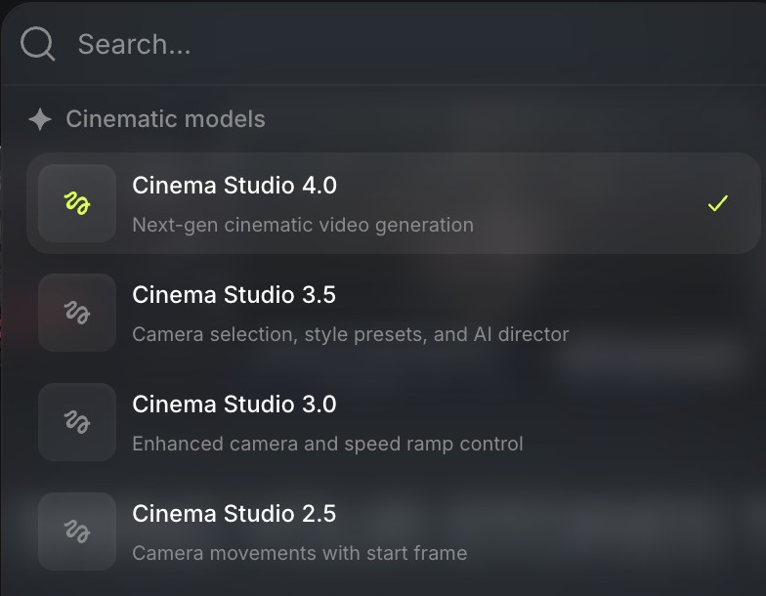
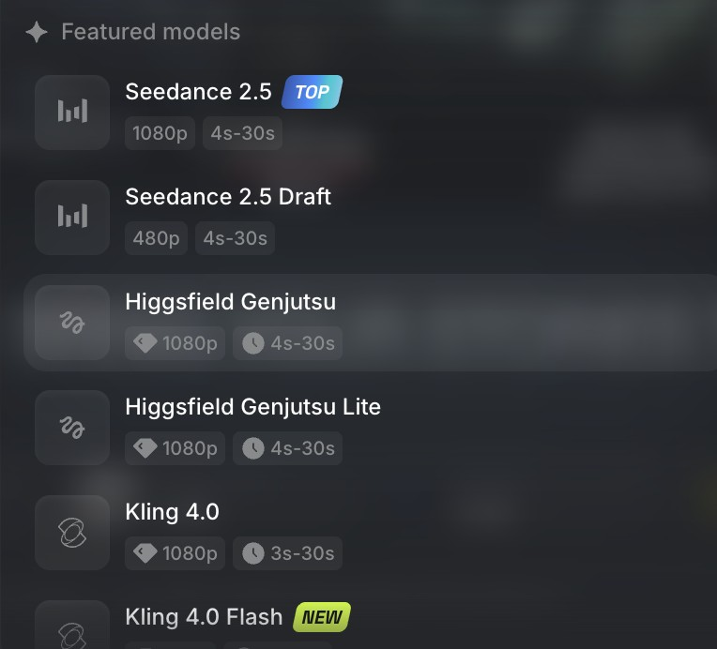
MODELS · WHERE TO CHOOSE
Two menus, one decision: which engine shoots this take?
You will compare two of these on the same prompt in Lab 9
Cinema Studio versions
4.0 is the next-gen cinematic model; 3.5 added camera selection, style presets and AI Director; 3.0 added speed ramps; 2.5 moves the camera from a start frame.
The video model list
Seedance 2.5 (TOP) and its 480p Draft, Genjutsu and Genjutsu Lite, Kling 4.0 and the new 4.0 Flash, each with its resolution and 3–30 s range.
© Tertiary Infotech Academy Pte Ltd
Generative AI for Video Creation · C1373
29

Slide 30
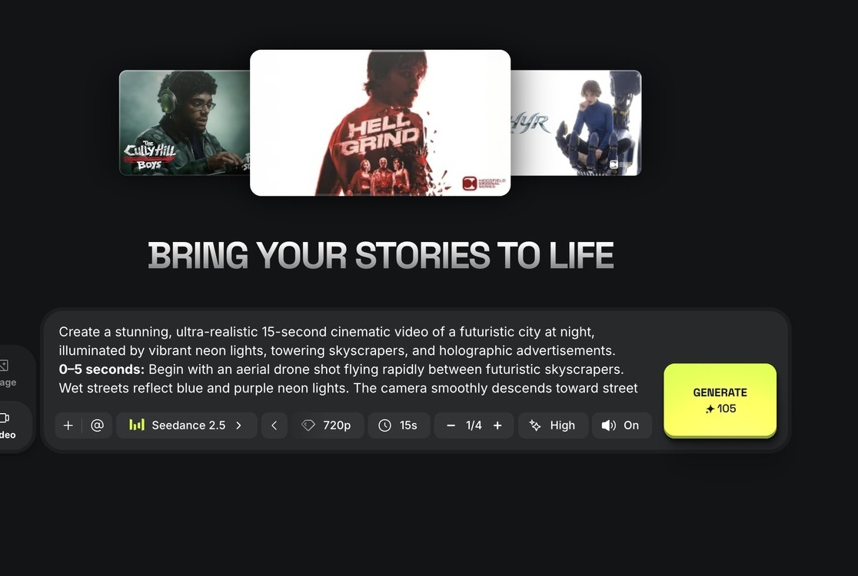
CINEMA STUDIO · VIDEO
Type one line, get fifteen seconds of film
The fastest route from idea to clip, and the one Lab 1 starts with
Describe the scene
Plain English in the prompt box; @ adds a saved character or location.
1
Pick the model
Seedance 2.5 here; switch to Draft for cheap tests.
2
Set quality and length
720p and 15 s cost 105 credits; 1080p costs 240.
1
3
4
2
3
Generate
Credits are shown on the button before you press it.
4
© Tertiary Infotech Academy Pte Ltd
Generative AI for Video Creation · C1373
30

Slide 31
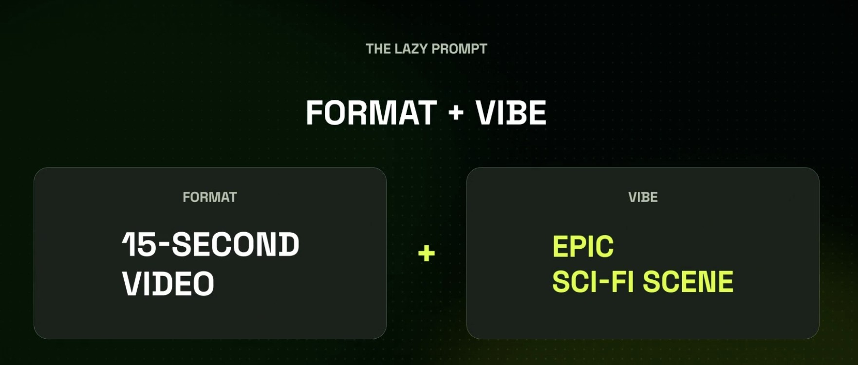
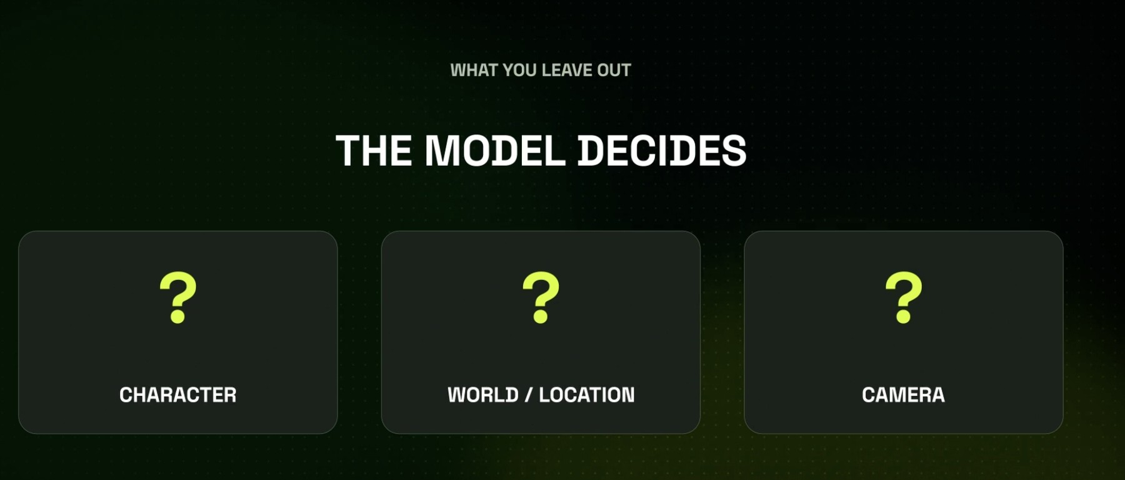
THE LAZY PROMPT
A lazy prompt works, but the model makes your choices
Speed now, inconsistency later: know the trade before you press Generate
Format + vibe
'15-second video' + 'epic sci-fi scene' is enough to generate. That is the lazy prompt you type first in Lab 1.
What you leave out, the model decides
Character, world/location and camera all become the model's guess, so every take tells a different story.
© Tertiary Infotech Academy Pte Ltd
Generative AI for Video Creation · C1373
31
Notes:
Run the lazy prompt live on Draft (45 credits). Ask the room to name what the model chose for them.

Slide 32

LAB 1 PREVIEW · TESTED IN HIGGSFIELD
We ran the lazy prompt: the model chose everything
Same prompt you will type in Lab 1. No character, no plot: proof that unbriefed means undirected
THE SHOTS WE PROMPTED
Prompt
'Create a 15-second video of an epic sci-fi scene.'
Character
none: the model left people out
World
abstract space and crystal shards
Camera
a warp-speed fly-through, no story beats
Lesson
brief who / where / what happens (Lab 2)
▶ Click to play · Seedance 2.5 Draft · 480p · 16:9 · 15 s · 45 credits · run 9 Nov 2026
© Tertiary Infotech Academy Pte Ltd
Generative AI for Video Creation · C1373
32
Notes:
Rendered for this course on 9 Nov 2026 as a Seedance 2.5 Draft (45 credits). Learners' takes will differ: that variation is the point.

Slide 33
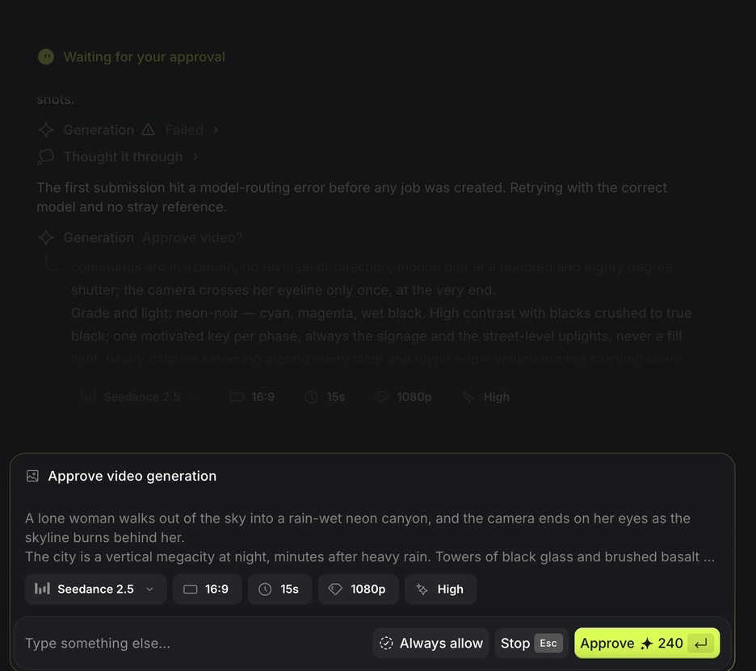
SUPERCOMPUTER · THE APPROVAL CARD
Supercomputer asks before it spends a credit
An agent with a budget gate: you stay the producer
The prompt it wrote
Read the scene, shots and grade it built from your chat.
1
The settings
Model, ratio, length, resolution and quality, all editable.
2
Approve with the price
240 credits for 15 s at 1080p; switch to Draft first.
3
1
Leave 'Always allow' off
Approve each spend by hand in class.
2
4
4
3
© Tertiary Infotech Academy Pte Ltd
Generative AI for Video Creation · C1373
33
Notes:
Supercomputer is Higgsfield's agent ('powered by Opus 5.5' on the home tile). It can call every Higgsfield tool; the approval card is where a human stays in charge.

Slide 34
TYPES OF QUALITY ISSUES
Six defects every AI video can have
Identity drift
The hero's face, hair or clothes change between shots.
Prop teleport
The case swaps hands or vanishes mid-scene.
1
2
Broken physics
Hands merge, liquids melt, people walk through tables.
Audio mismatch
Footsteps without feet, lips out of sync, music over dialogue.
3
4
Garbled text
Signs and labels turn into nonsense letters.
Wrong spec
Wrong ratio, 480p left in the final, cut mid-movement.
5
6
© Tertiary Infotech Academy Pte Ltd
Generative AI for Video Creation · C1373
34

Slide 35
TOPIC 01 · HANDS-ON
Sign Up and Make Your First 15-Second Video
LAB 1
MAPS TO spot quality issues; generate a new video from scratch on a GenAI video platform
Sign up to Higgsfield through the course link, tour the two doors (Supercomputer and Cinema Studio), then make the same 15-second sci-fi clip twice: once from a one-line lazy prompt, once after Supercomputer interviews you. Compare what the model decided for you.
You'll build
Two 15-second Draft clips of the same idea, plus a log of what the model decided and three quality issues you spotted.
Tools: Higgsfield: Cinema Studio (Video), Supercomputer, Seedance 2.5 Draft
© Tertiary Infotech Academy Pte Ltd
Generative AI for Video Creation · C1373
35

Slide 36
LAB 1 · HOW IT RUNS — FULL STEPS IN THE LEARNER GUIDE
How Lab 1 Runs
1
2
3
4
5
Sign up via the course link
Tour Supercomputer + Cinema Studio
Lazy prompt, Draft take
Supercomputer interviews you
Compare and log issues
© Tertiary Infotech Academy Pte Ltd
Generative AI for Video Creation · C1373
36

Slide 37
LAB 1 · COPY-AND-ADAPT PROMPTS
Lab 1 — Prompts
PROMPT — THE LAZY PROMPT (FORMAT + VIBE)
Create a 15-second video of an epic sci-fi scene.
PROMPT — MAKE SUPERCOMPUTER INTERVIEW YOU FIRST
I want a 15-second epic sci-fi scene for a cinema-style trailer moment.
Before you write or generate anything, ask me up to five short questions about:
the main character, the world/location, what happens, the camera, and the sound.
Then write the full prompt with timed shots and wait for my approval.
Use Seedance 2.5 Draft, 16:9, 15 seconds, sound on.
© Tertiary Infotech Academy Pte Ltd
Generative AI for Video Creation · C1373
37

Slide 38
LAB 1 · VERIFY
Sign Up and Make Your First 15-Second Video
✓ Check your work
Both clips are 15 s Drafts in one project; your log names the character, world and camera the model chose and three concrete quality issues, and says which ones the interviewed take fixed.
Detailed step-by-step instructions: Learner Guide + the lab folder in labs/.
© Tertiary Infotech Academy Pte Ltd
Generative AI for Video Creation · C1373
38

Slide 39
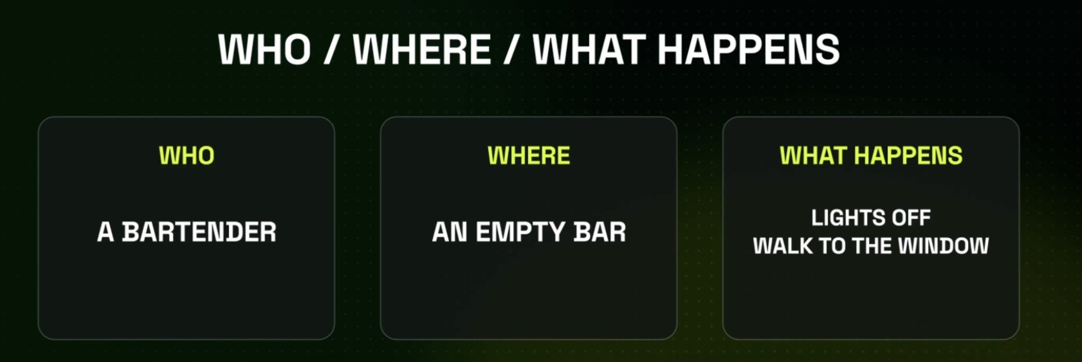
SCRIPT · THE THREE-LINE BRIEF
Brief like a director: who, where, what happens
Three lines remove the three guesses the lazy prompt left to the model
WHO
One character with a job and a look: 'a bartender'.
WHERE
One location you could photograph: 'an empty bar'.
WHAT HAPPENS
One visible action with an ending: 'lights off, walk to the window'.
© Tertiary Infotech Academy Pte Ltd
Generative AI for Video Creation · C1373
39

Slide 40
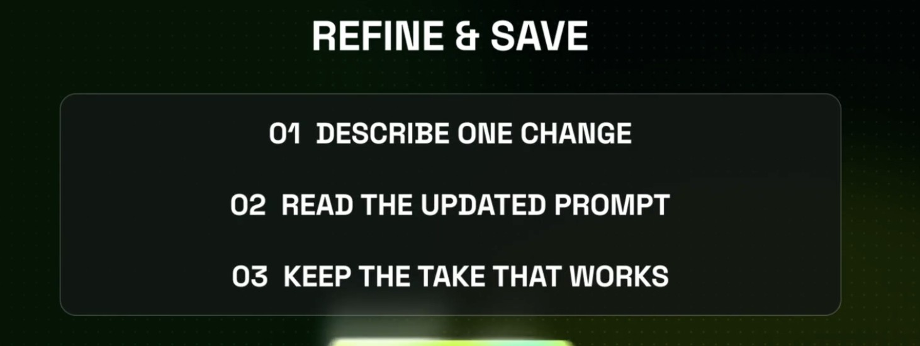
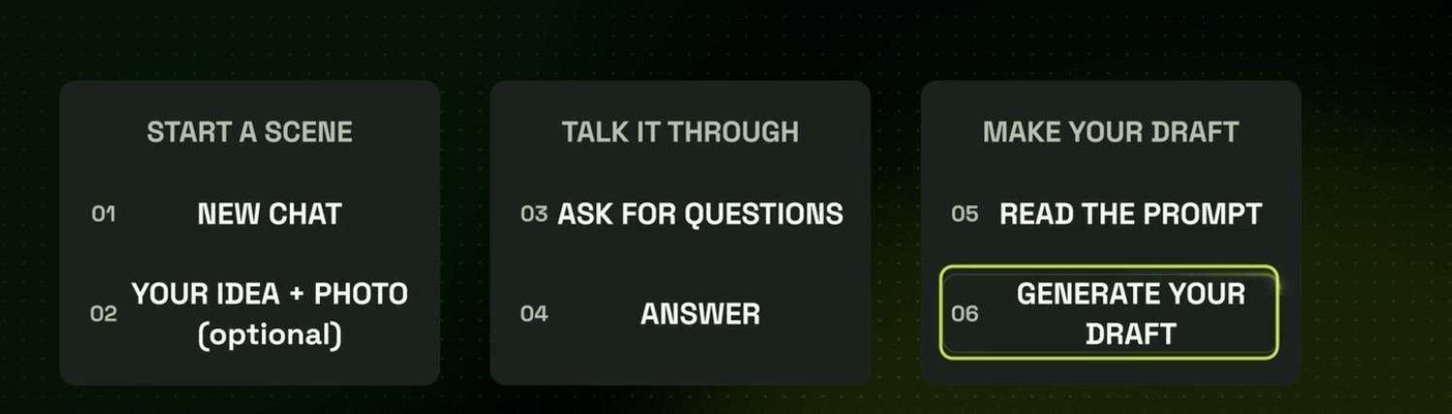
SUPERCOMPUTER · THE WORKING LOOP
Talk the scene through, then refine one change at a time
The loop you will repeat in every lab from here on
Start → talk → draft
New chat, your idea (and a photo if you have one), let it ask questions, answer, read its prompt, generate the draft.
Refine & save
Describe ONE change, read the updated prompt, keep the take that works. One change per run tells you what fixed it.
© Tertiary Infotech Academy Pte Ltd
Generative AI for Video Creation · C1373
40

Slide 41
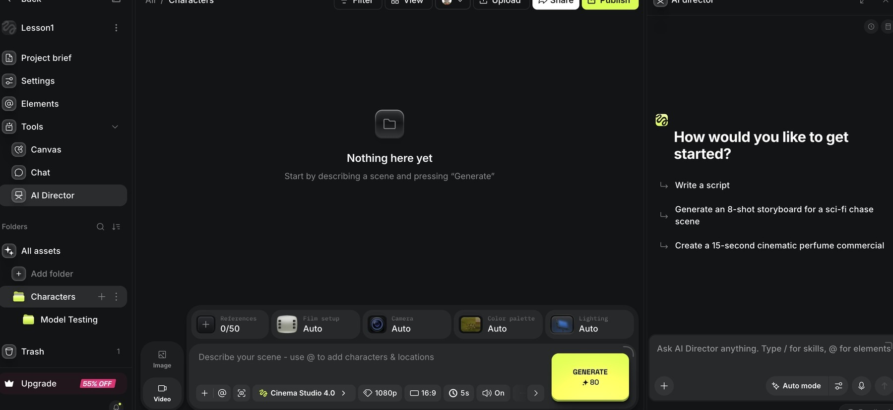
PROJECTS · AI DIRECTOR
AI Director turns a brief into a script and storyboard
Your writers' room lives inside the project, next to the footage
1
2
3
4
1
Project brief
2
Elements
3
AI Director
4
Suggested starts
Where the locked script and shot list live.
The characters, locations and props this project can call.
Opens the director chat inside the project.
'Write a script', 'Generate an 8-shot storyboard', '15-second perfume commercial'.
© Tertiary Infotech Academy Pte Ltd
Generative AI for Video Creation · C1373
41

Slide 42
REVIEW THE SCRIPT BEFORE YOU SHOOT
Good Story Elements
Identifiable hero
A protagonist the audience recognises themselves in.
A clear desire
What does the hero want? Ambiguity kills engagement.
1
2
A real obstacle
No obstacle, no story: conflict is the heart of drama.
Action & outcome
The hero acts; the world changes. Show the transformation.
3
4
Resolution
End the story world in a new state, with your call to action.
The story spine
Once upon a time… then one day… but… so… until finally…
5
6
© Tertiary Infotech Academy Pte Ltd
Generative AI for Video Creation · C1373
42

Slide 43
THE HIGGSFIELD PROMPT FORMAT
Build every prompt in three parts
1
2
3
4
5
Scene context
References
Shots
Sound
Settings
visible action, 1–2 sentences
@elements and their roles
numbered, timed, sized
ambience, foley, dialogue
model, ratio, length, Draft
WRITE IT LIKE A CALL SHEET
Every shot names a size, an action and a camera. The model stops guessing and starts following.
© Tertiary Infotech Academy Pte Ltd
Generative AI for Video Creation · C1373
43

Slide 44
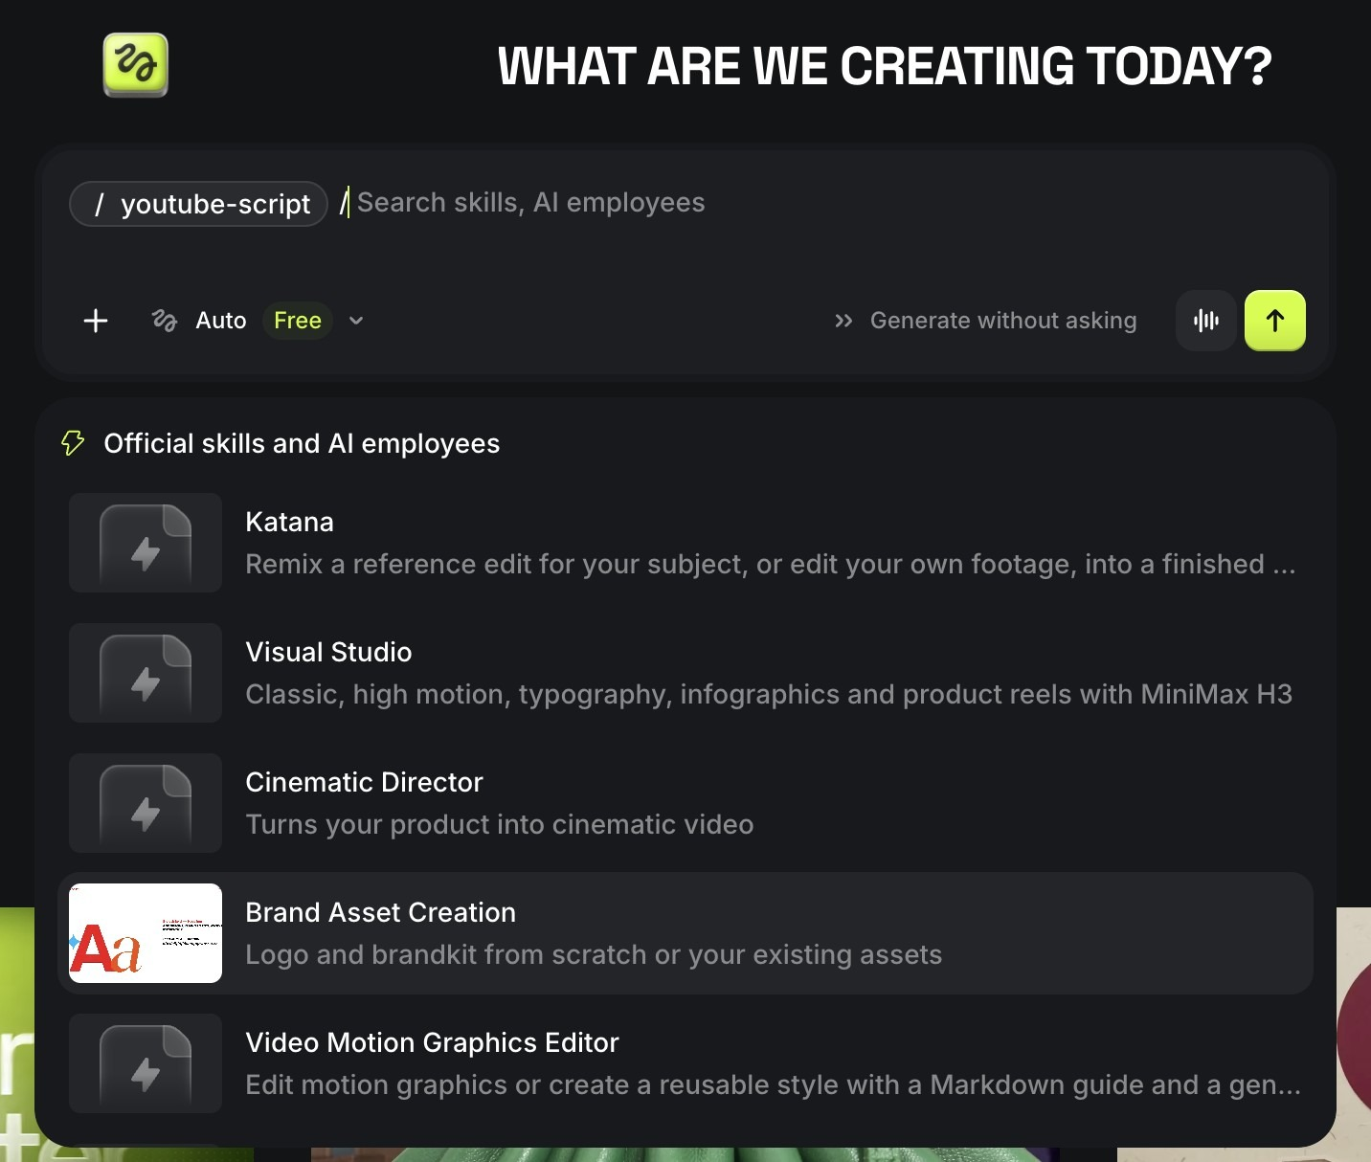
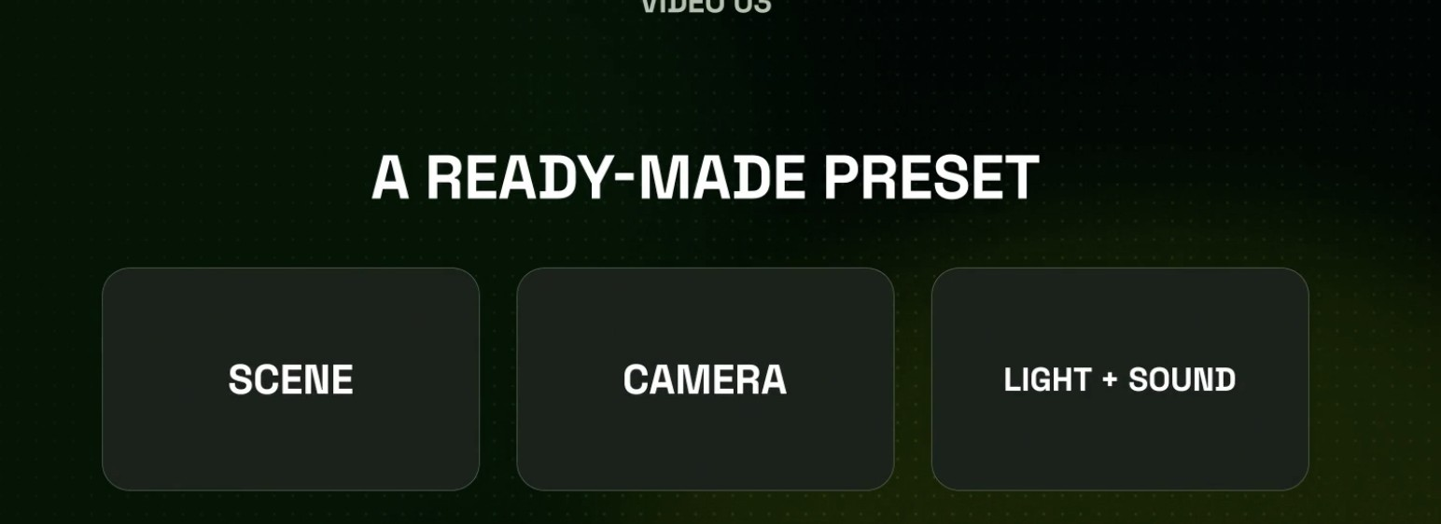
SHORTCUTS · PRESETS AND SKILLS
Ready-made presets and skills do the heavy lifting
Lab 2 uses /youtube-script; Lab 9 uses /product-photoshoot
A preset packs scene, camera, light and sound
Pick one and the model receives a full brief. Good for speed; you still check it fits your story.
Skills: rules for a specific job
Type / in Supercomputer: Katana, Visual Studio, Cinematic Director, Brand Asset Creation, Video Motion Graphics Editor, /youtube-script.
© Tertiary Infotech Academy Pte Ltd
Generative AI for Video Creation · C1373
44

Slide 45
SUPERCOMPUTER · SKILLS
Add a skill to Supercomputer: three ways
Install from the Marketplace
Skills in the left sidebar → browse official and community skills → Install. Higgsfield calls Skills 'installable workflows'.
Import what you already have
Bring your skills and memory from Claude, Claude Code, Codex or ChatGPT (the import uses the Higgsfield MCP connection).
1
2
Create your own
A skill is rules + guidelines for one job: when to use it, the steps, the style rules, the output format.
Run it with a slash
Type / in the Supercomputer prompt and pick the skill: /youtube-script, /product-photoshoot, /house-standards.
3
4
© Tertiary Infotech Academy Pte Ltd
Generative AI for Video Creation · C1373
45
Notes:
Sources: higgsfield.ai/supercomputer-intro (Skills = installable workflows from the Marketplace; import from Claude, Claude Code, Codex, ChatGPT). Confirm the exact Create/Import button labels on your own account before class; the UI changes often.

Slide 46
TOPIC 01 · HANDS-ON
Write the Script and Shot List with Supercomputer and AI Director
LAB 2
MAPS TO review scripts to conceptualise the edits needed; edit video scripts with GenAI
Turn a three-line idea (who, where, what happens) into a 15-second script and a timed shot list. AI Director drafts it inside your project; you review it against the story elements and decide the edits: shot sizes, cuts, camera and sound. Then you refine it one change at a time.
You'll build
A reviewed 15-second script and a 6-shot shot list in the three-part prompt format, saved in your project brief.
Tools: Higgsfield: Projects, AI Director, Supercomputer (/youtube-script skill)
© Tertiary Infotech Academy Pte Ltd
Generative AI for Video Creation · C1373
46

Slide 47
LAB 2 · HOW IT RUNS — FULL STEPS IN THE LEARNER GUIDE
How Lab 2 Runs
1
2
3
4
5
Who / where / what happens
AI Director drafts script
Review against story elements
Rewrite as a 3-part prompt
Refine one change at a time
© Tertiary Infotech Academy Pte Ltd
Generative AI for Video Creation · C1373
47

Slide 48
LAB 2 · COPY-AND-ADAPT PROMPTS
Lab 2 — Prompts (1/2)
PROMPT — BRIEF AI DIRECTOR — WHO / WHERE / WHAT HAPPENS
WHO: a bartender in her thirties, tired but proud of her bar.
WHERE: her empty neighbourhood bar after closing time.
WHAT HAPPENS: she switches the lights off one by one and walks to the window as the city lights come on.
Write a 15-second cinematic script, then a 6-shot storyboard with shot sizes and timings.
PROMPT — THREE-PART PROMPT SKELETON
Scene context: <the visible action in one or two sentences>.
References: <@element — role, 100% as shown in the reference image>.
Shots (cut between each):
1. 0–3s: <shot size>, <action>, <camera>.
2. 3–6s: ...
Sound: <ambience>, <footsteps/clothing>, <dialogue or none>.
© Tertiary Infotech Academy Pte Ltd
Generative AI for Video Creation · C1373
48

Slide 49
LAB 2 · COPY-AND-ADAPT PROMPTS
Lab 2 — Prompts (2/2)
PROMPT — SCRIPT CRITIQUE
Act as a film editor. Check this script for: weak opening shot, unclear hero, no obstacle, no visual payoff, and shots that cannot be filmed in 15 seconds. List each issue, then rewrite only the weakest shot.
© Tertiary Infotech Academy Pte Ltd
Generative AI for Video Creation · C1373
49

Slide 50
LAB 2 · VERIFY
Write the Script and Shot List with Supercomputer and AI Director
✓ Check your work
The script fits 15 s, every shot has a size, a camera instruction and a time, the story-elements review names at least two edits you made, and the prompt is in the three-part format.
Detailed step-by-step instructions: Learner Guide + the lab folder in labs/.
© Tertiary Infotech Academy Pte Ltd
Generative AI for Video Creation · C1373
50

Slide 51
ONE SCENE ≠ EVERY PLATFORM
Tailoring the cut to the platform
YouTube
TikTok / Shorts
Instagram Reels
Length
60 s – 10 min
15 – 60 s
15 – 90 s
Ratio
16:9 landscape
9:16 vertical
9:16 vertical
Pacing
Build with structure
Hook in 1–3 s, fast cuts
Aesthetic-first, fast
Captions
Recommended
Essential (muted viewing)
Essential
AI label
Disclose realistic AI content
AI-generated label
Label AI content
TIP: Higgsfield's Reframe turns a 16:9 take into 9:16; plan the safe area when you write the shots.
© Tertiary Infotech Academy Pte Ltd
Generative AI for Video Creation · C1373
51

Slide 52
BUDGET THE WORK PLAN IN CREDITS
Draft first: the cheapest quality gate you have
Read on Higgsfield, 9 Nov 2026: put these numbers in your Lab 3 work plan
45
240
7
credits
a 15 s Seedance 2.5 Draft at 480p
credits
the same 15 s at 1080p, 5× the price
days
to finalise any Draft you keep at 1080p
Rule for every lab: test the idea on Draft, finalise only the take you would show a client.
© Tertiary Infotech Academy Pte Ltd
Generative AI for Video Creation · C1373
52

Slide 53
LAB 3 PREVIEW · CREATE YOUR OWN SKILL
Turn your standards sheet into a skill
Part of the skill
What you write
Example: /house-standards
Name
short, lower-case, hyphenated
house-standards
When to use
the job it does
Every video for our agency's clients
Rules
the non-negotiables
Saved Elements only; 1080p finals; AI label on; no real likeness without consent
Steps
the order of work
Draft 480p → review → finalise 1080p → checklist → export 16:9 + 9:16
Output format
what it must hand back
Prompt in three parts + a credit estimate + a pass/fail checklist
TIP: A skill turns a one-off standards document into a rule the agent follows on every job: your standards become enforced, not just written.
© Tertiary Infotech Academy Pte Ltd
Generative AI for Video Creation · C1373
53

Slide 54
TOPIC 01 · HANDS-ON
Set the House Rules: Standards, Work Plan and Credit Budget
LAB 3
MAPS TO quality issues to prevent; develop editing standards and guidelines; develop work plans and timelines
Have Supercomputer draft the two documents every Higgsfield production needs: a one-page standards and guidelines sheet (platform specs, legal and AI-disclosure rules, quality gates) and a post-production work plan with timelines and a credit budget built on real Draft and 1080p costs.
You'll build
A one-page standards & guidelines sheet, a phased work plan with timelines and a credit budget, and your own /house-standards skill.
Tools: Higgsfield: Supercomputer (Ask mode, Skills)
© Tertiary Infotech Academy Pte Ltd
Generative AI for Video Creation · C1373
54

Slide 55
LAB 3 · HOW IT RUNS — FULL STEPS IN THE LEARNER GUIDE
How Lab 3 Runs
1
2
3
4
5
Draft standards with Supercomputer
Add legal + AI-disclosure rules
Build the work plan + credits
Save the rules as a skill
Test /house-standards
© Tertiary Infotech Academy Pte Ltd
Generative AI for Video Creation · C1373
55

Slide 56
LAB 3 · COPY-AND-ADAPT PROMPTS
Lab 3 — Prompts (1/3)
PROMPT — STANDARDS & GUIDELINES SHEET
Draft a one-page video standards & guidelines sheet for a Singapore agency making 15–30 second AI videos in Higgsfield.
Cover: resolution and frame rate; aspect ratio per platform (YouTube 16:9, TikTok/Reels/Shorts 9:16); audio level and captions;
branding; character and location consistency (saved Elements only); commercial-use rights on our plan;
PDPA consent for real faces and voices; AI-content disclosure labels on TikTok and YouTube; IMDA/ASAS advertising codes.
Format as a table.
© Tertiary Infotech Academy Pte Ltd
Generative AI for Video Creation · C1373
56

Slide 57
LAB 3 · COPY-AND-ADAPT PROMPTS
Lab 3 — Prompts (2/3)
PROMPT — WORK PLAN WITH TIMELINES AND CREDITS
Create a post-production work plan for a 15-second promo due in 3 working days, made entirely in Higgsfield.
Phases: script lock, Elements (characters, locations, props), 480p Draft takes, 1080p finals, fix & finish
(replace, upscale, captions, music), client review, export 16:9 + 9:16, publish.
For each phase give owner, duration, dependency, deliverable and credits (45 per 15 s Draft, 240 per 15 s 1080p final,
max three Drafts per shot). Format as a timeline table with a credit total.
© Tertiary Infotech Academy Pte Ltd
Generative AI for Video Creation · C1373
57

Slide 58
LAB 3 · COPY-AND-ADAPT PROMPTS
Lab 3 — Prompts (3/3)
PROMPT — SAVE THE RULES AS A SKILL
Save these standards as a reusable skill named house-standards.
When to use: every video we make for clients.
Rules: saved Elements only; Draft at 480p before any 1080p final; 1080p finals; 16:9 and 9:16 exports;
AI-generated label on; no real person's face or voice without written consent; music cleared for commercial use.
Steps: brief -> three-part prompt -> Draft -> review -> finalise -> quality checklist -> export.
Output: the three-part prompt, a credit estimate and a pass/fail checklist.
© Tertiary Infotech Academy Pte Ltd
Generative AI for Video Creation · C1373
58

Slide 59
LAB 3 · VERIFY
Set the House Rules: Standards, Work Plan and Credit Budget
✓ Check your work
The sheet names concrete specs per platform and at least three legal or disclosure rules; the plan covers every phase to publishing within 3 days and its credit total matches 45/240 rates; /house-standards answers a test idea with your rules applied.
Detailed step-by-step instructions: Learner Guide + the lab folder in labs/.
© Tertiary Infotech Academy Pte Ltd
Generative AI for Video Creation · C1373
59

Slide 60
TOPIC RECAP · WHAT YOU CAN NOW DO
Recap — Create and Edit Video Script Using Generative AI (GAI)
Lab 1 — Sign Up and Make Your First 15-Second Video
You built: Two 15-second Draft clips of the same idea, plus a log of what the model decided and three quality issues you spotted.
1
Lab 2 — Write the Script and Shot List with Supercomputer and AI Director
You built: A reviewed 15-second script and a 6-shot shot list in the three-part prompt format, saved in your project brief.
2
Lab 3 — Set the House Rules: Standards, Work Plan and Credit Budget
You built: A one-page standards & guidelines sheet, a phased work plan with timelines and a credit budget, and your own /house-standards skill.
3
© Tertiary Infotech Academy Pte Ltd
Generative AI for Video Creation · C1373
60

Slide 61
TOPIC 2
1
Lab 4 — Build Your Elements: Characters, Locations and Props
Improve Video Footage on GAI Powered Video Platforms
2
Lab 5 — Direct Shots and Takes in Cinema Studio
3
Lab 6 — Cut, Caption and Assess the Scene
Elements: characters, locations, props · references · Cinema Studio shots & takes · Draft mode · assess the cut
© Tertiary Infotech Academy Pte Ltd
Generative AI for Video Creation · C1373
61

Slide 62
KEY CONCEPTS
Key Concepts — Topic 2
Elements
Save a character, location or prop once with an @handle and reuse it in every shot: the fix for drifting faces and sets.
References
Up to 50 per generation (30 images, 10 videos, 10 audio), each given a role: character, location, camera move or voice.
1
2
Shots & takes
One continuous shot or multishot with cuts; each run is a take you keep, compare or replace.
Cinematic controls
Camera body, lens, aperture, movement, lighting, colour palette, genre, era and tempo.
3
4
Draft mode
Seedance 2.5 Draft renders 480p for 45 credits; finalise only the take that works at 1080p.
Assessing footage
Resolution, continuity, motion, audio, pacing and compliance, judged take by take.
5
6
© Tertiary Infotech Academy Pte Ltd
Generative AI for Video Creation · C1373
62

Slide 63
WHAT YOU'LL DO
Hands-On Labs — Topic 2
Lab 4 — Build Your Elements: Characters, Locations and Props
Five saved Elements, two characters, two locations and one prop, each with a reference image and an @handle.
4
Lab 5 — Direct Shots and Takes in Cinema Studio
Four Draft takes of one scene and one 1080p final of the best take, made from your Elements.
5
Lab 6 — Cut, Caption and Assess the Scene
A captioned 15–30 s cut in 16:9 and 9:16 with a scored quality checklist and a list of storytelling improvements.
6
© Tertiary Infotech Academy Pte Ltd
Generative AI for Video Creation · C1373
63

Slide 64
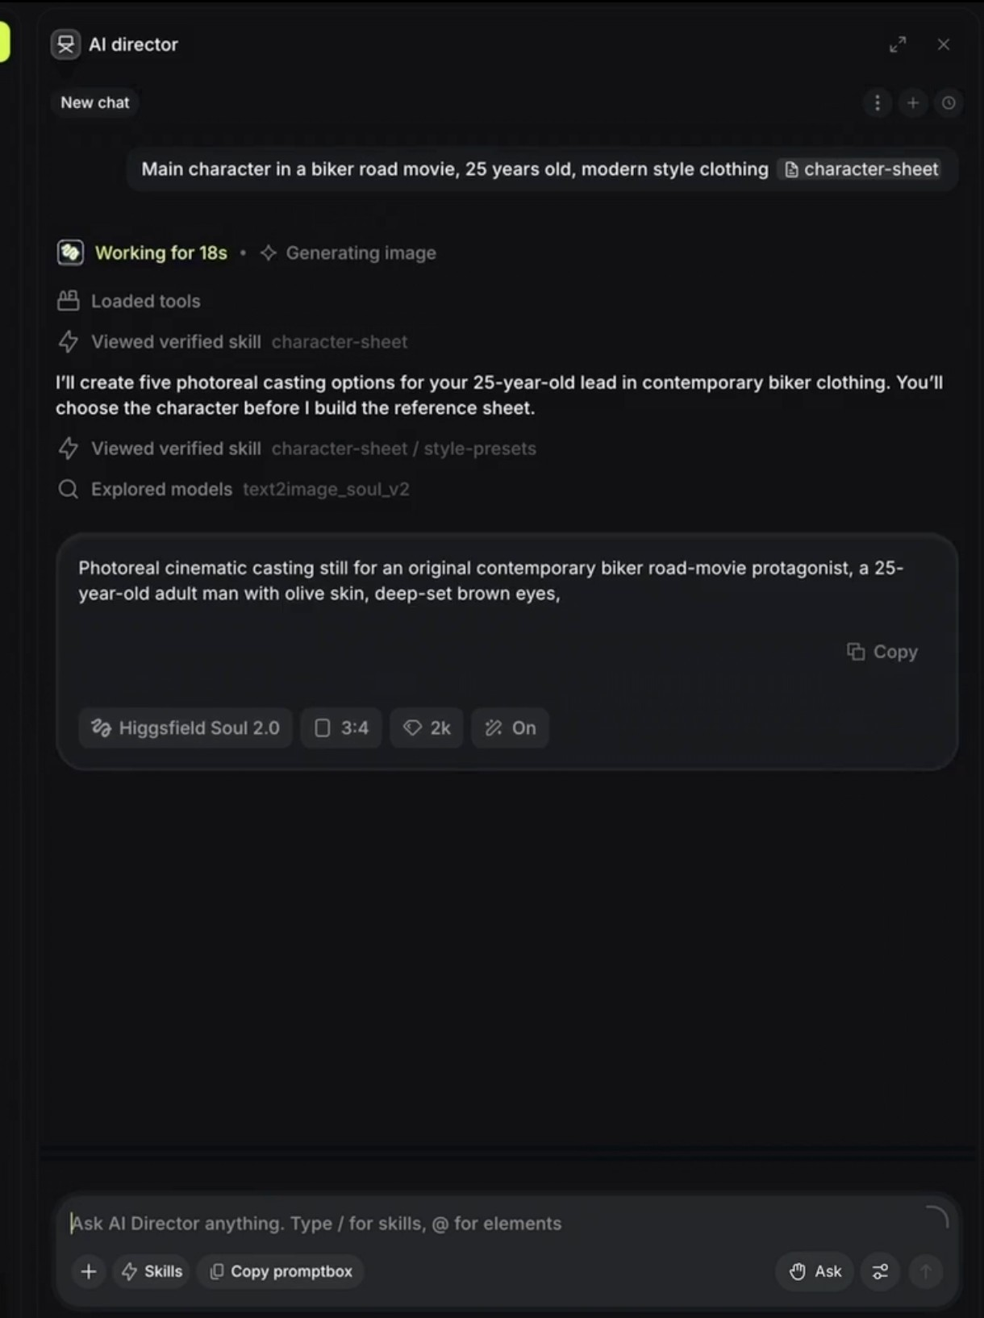
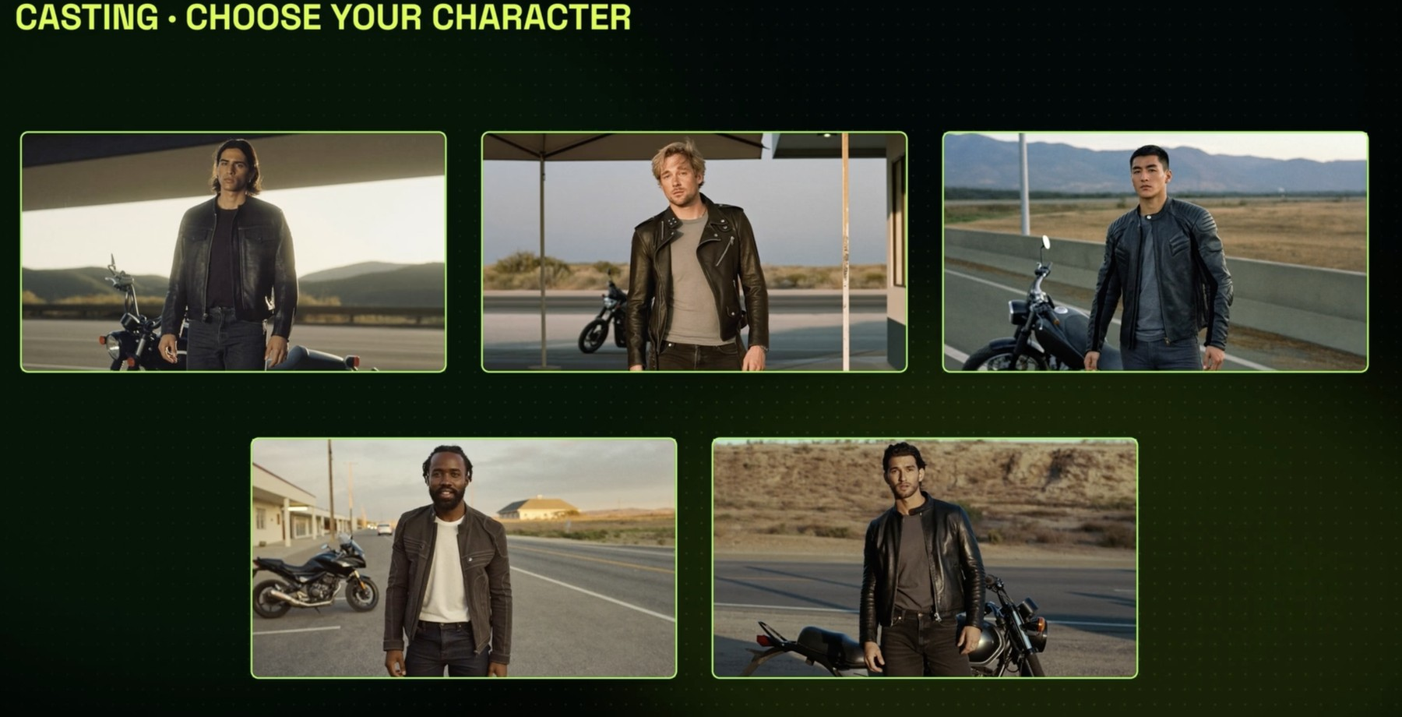
ELEMENTS · CHARACTERS
Cast your lead before you shoot a frame
A cast you chose on purpose beats a face the model invents every take
Ask Supercomputer to cast
'Main character in a biker road movie, 25, modern clothing'. It loads the character-sheet skill and writes a casting prompt for Soul 2.0.
Choose from five options
Five photoreal candidates. You pick one; only then does it build the reference sheet.
© Tertiary Infotech Academy Pte Ltd
Generative AI for Video Creation · C1373
64

Slide 65
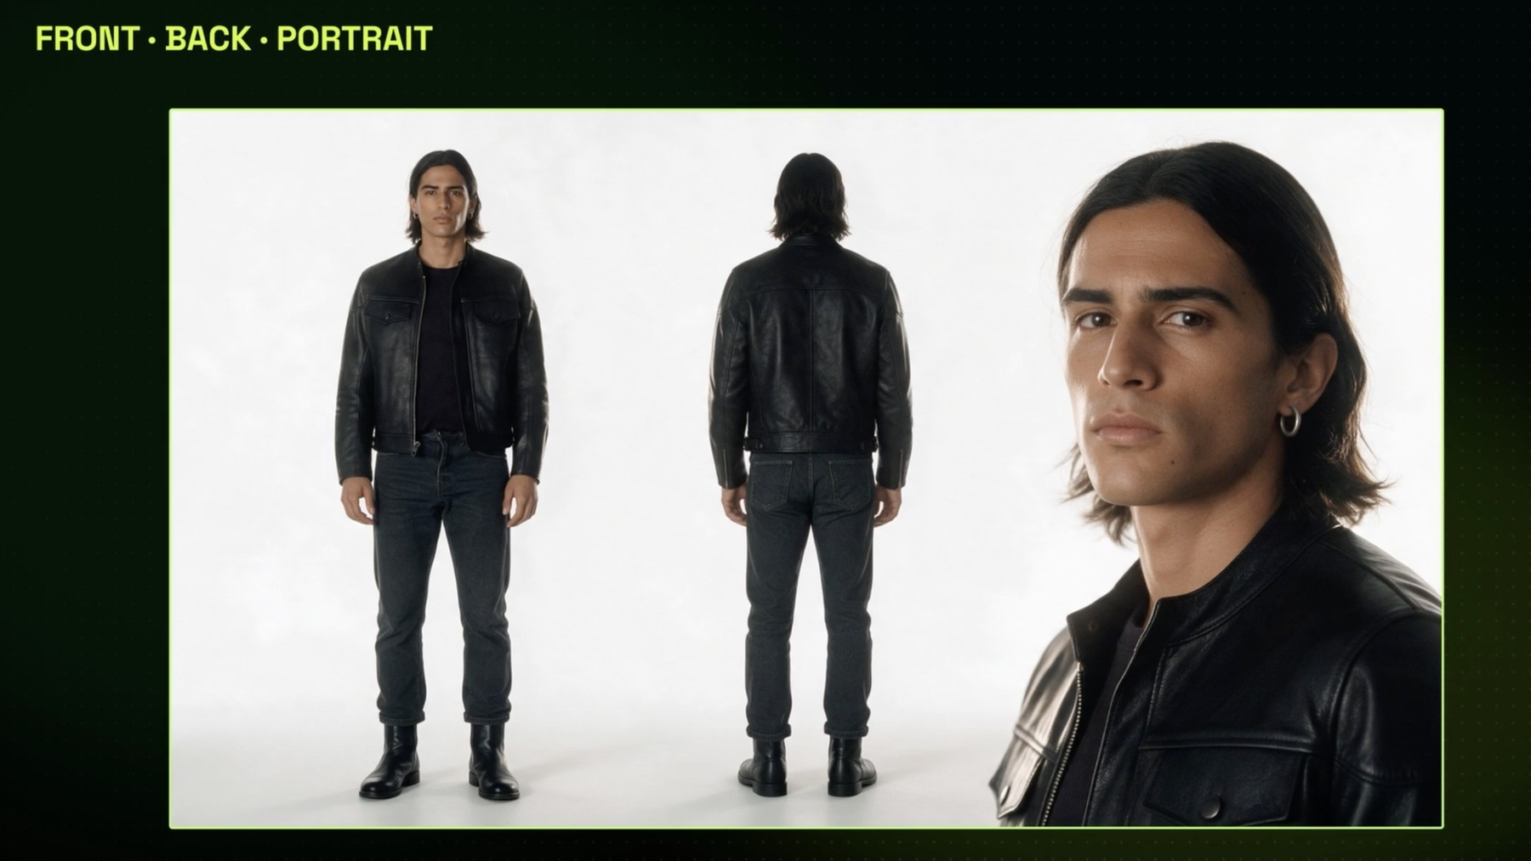
ELEMENTS · CHARACTER SHEET
One sheet, three views: the reference every shot obeys
Plain background, consistent light: the model copies exactly what it sees
Full body, front
Clothes, shoes, proportions.
Full body, back
What the camera sees when he walks away.
Face portrait
The identity every shot copies. Next: make it the only face on the sheet.
© Tertiary Infotech Academy Pte Ltd
Generative AI for Video Creation · C1373
65

Slide 66
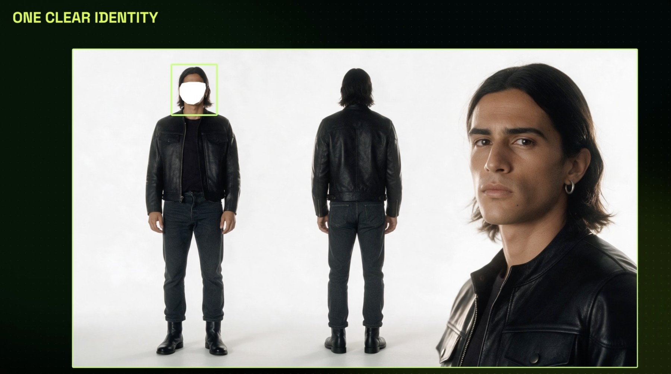
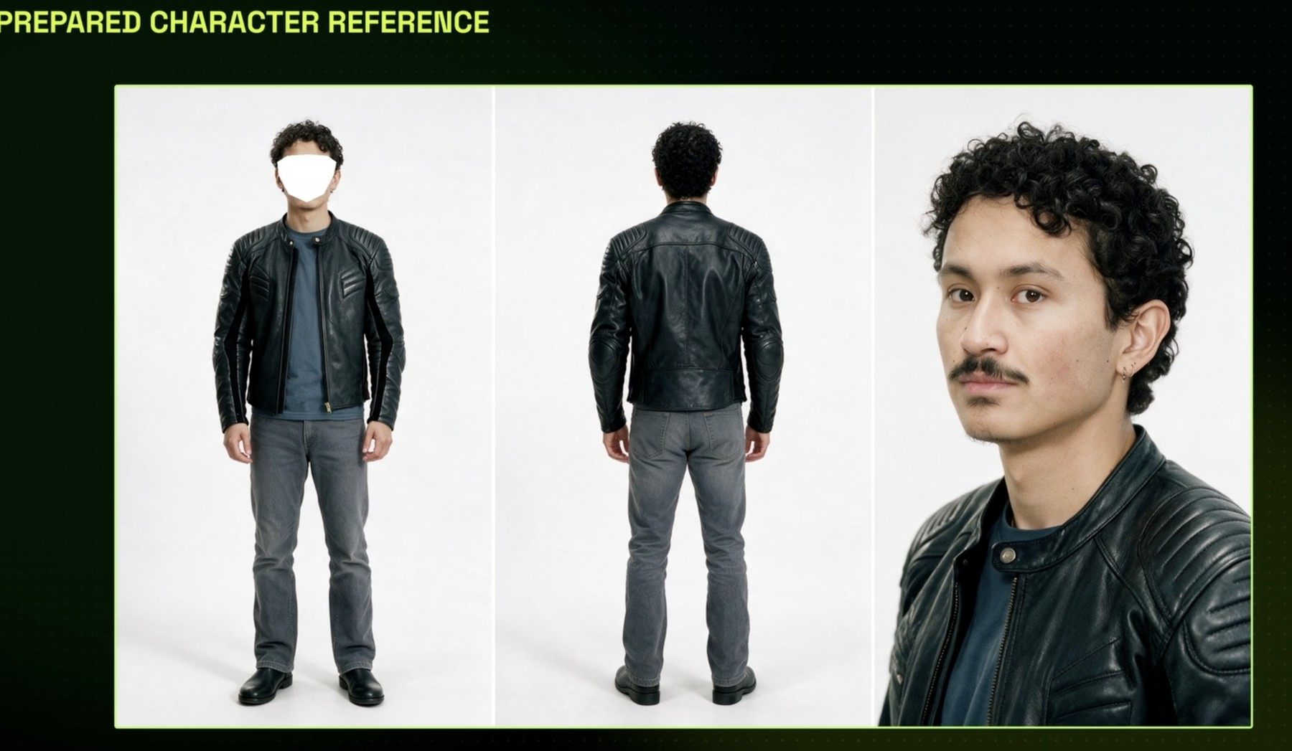
ELEMENTS · CONSISTENCY
Cover one face, keep one face: the trick that locks identity
Two faces on one sheet means two identities to blend; leave the model only one
Blank the full-body face
The white oval is deliberate. The small, soft face in the full-body view is hidden, so the model copies the sharp close-up into every shot.
Same trick for the friend
His full-body face is covered too. Each character has exactly one face to copy, so two people share a shot without swapping faces.
© Tertiary Infotech Academy Pte Ltd
Generative AI for Video Creation · C1373
66
Notes:
The covered face is not a defect. Higgsfield's character-sheet skill hides the face on the full-body view so the close-up portrait is the only face reference, which keeps the face identical from shot to shot. Outfit and body still come from the full-body views.

Slide 67
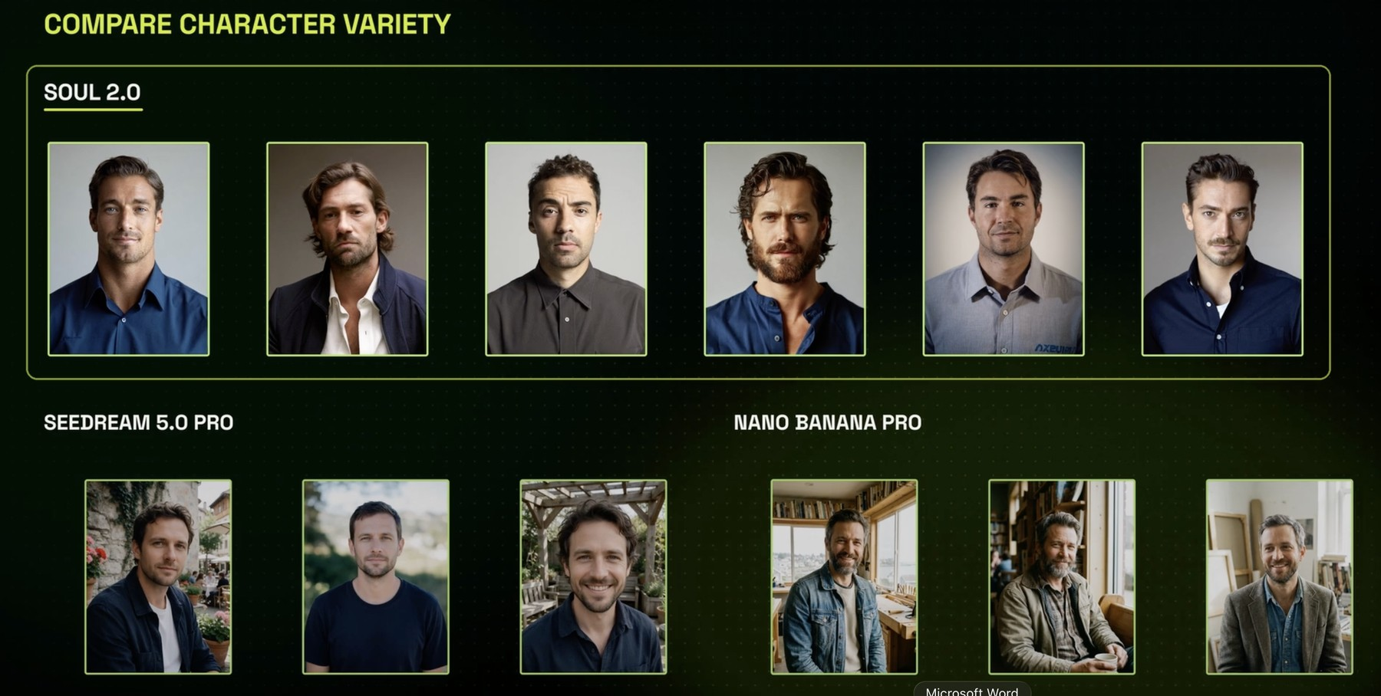
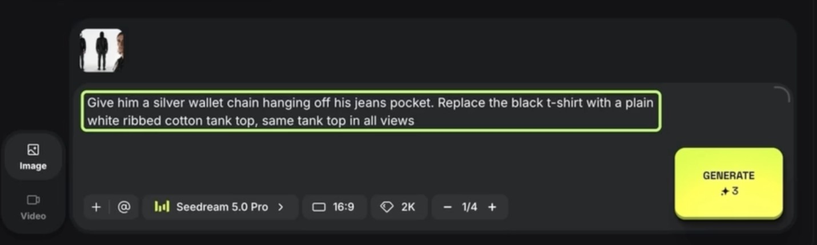
ELEMENTS · REFINE THE CHARACTER
Edit one detail and keep it in every view
Fix wardrobe on the sheet, not shot by shot
A targeted edit
'Give him a silver wallet chain… white ribbed tank top, same in all views.' Seedream 5.0 Pro, 3 credits.
Different models, different casts
Soul 2.0, Seedream 5.0 Pro and Nano Banana Pro each read the same brief their own way.
© Tertiary Infotech Academy Pte Ltd
Generative AI for Video Creation · C1373
67

Slide 68
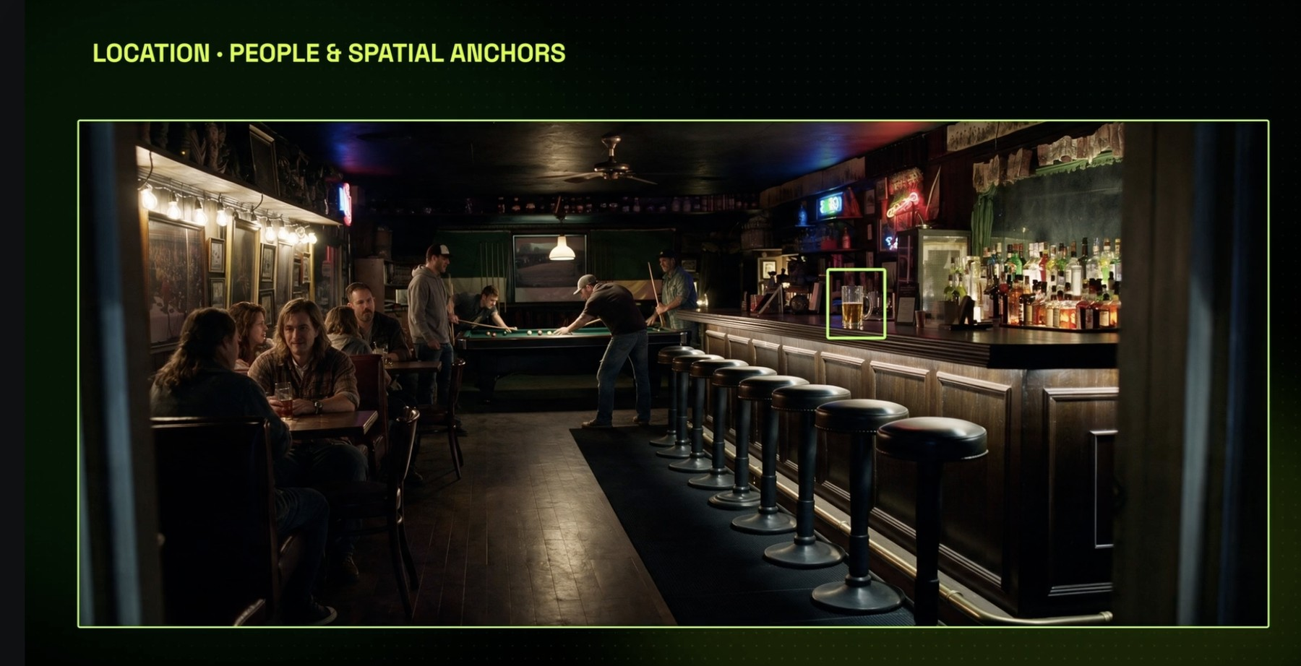
ELEMENTS · LOCATIONS
Build locations with anchors you can name in a shot
'He sits on the third stool' only works if the stool exists in the reference
Spatial anchors
The counter, the stools, the pool table, the window: things a shot can point at.
People optional
Extras give scale; your saved characters will replace them.
Save it
loc_bar-interior becomes @loc_bar-interior in every prompt.
© Tertiary Infotech Academy Pte Ltd
Generative AI for Video Creation · C1373
68

Slide 69
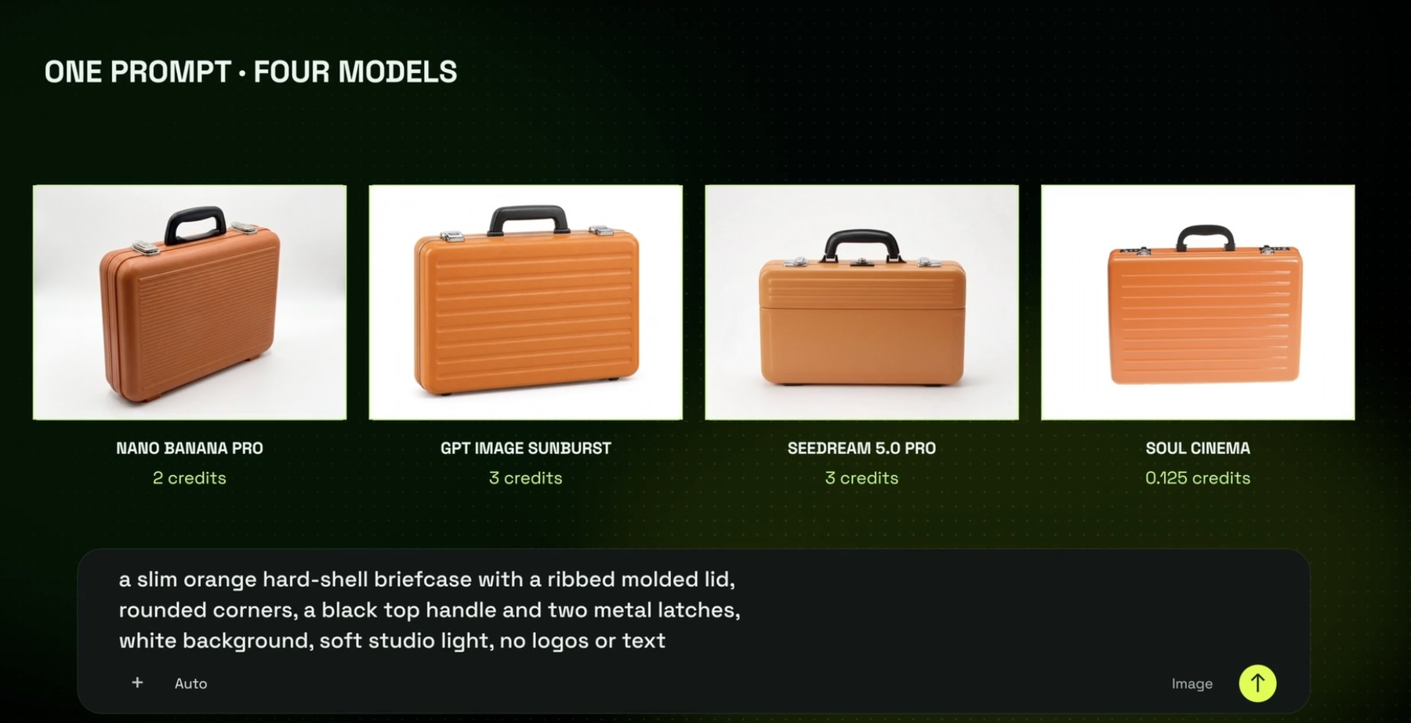
ELEMENTS · PROPS
A prop on four models: compare before you commit
The cheapest image is not always the cheapest choice: a wrong prop costs a re-shoot
Same prompt
A slim orange hard-shell briefcase, white background, no logos.
Different cost
Nano Banana Pro 2 credits, GPT Image Sunburst 3, Seedream 5.0 Pro 3, Soul Cinema 0.125.
Pick on fit
Shape, colour and detail that survive a close-up.
© Tertiary Infotech Academy Pte Ltd
Generative AI for Video Creation · C1373
69

Slide 70
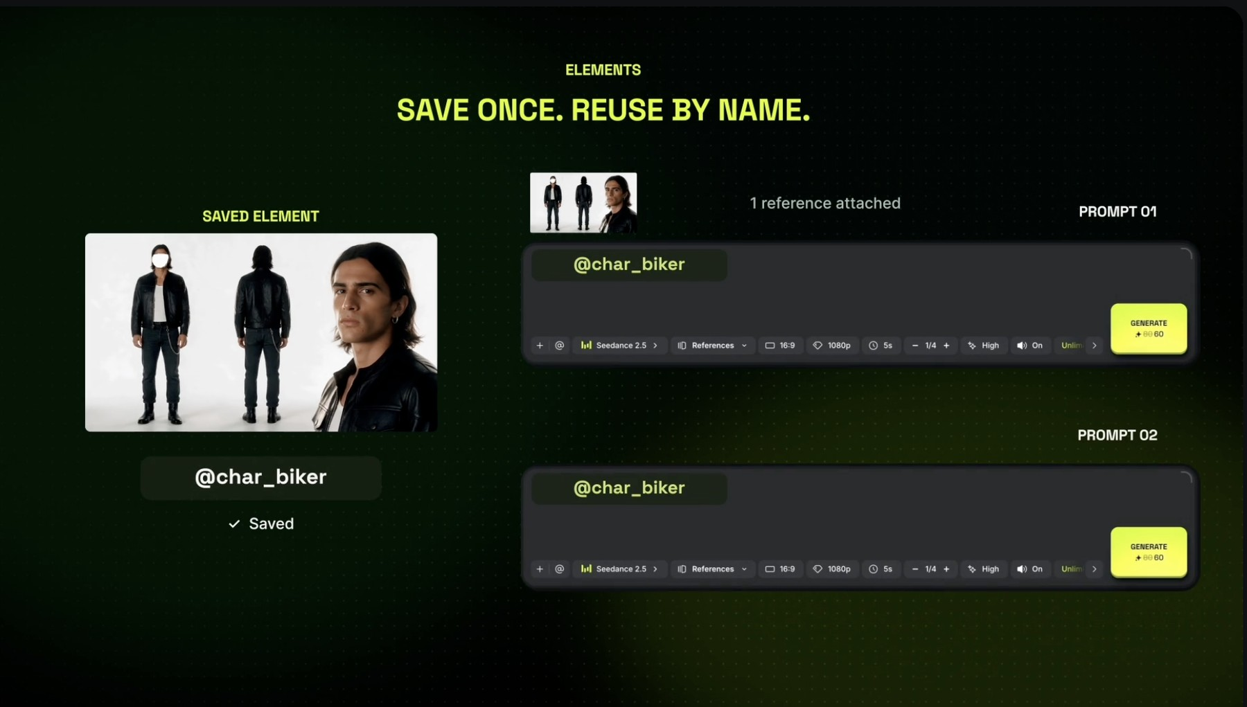
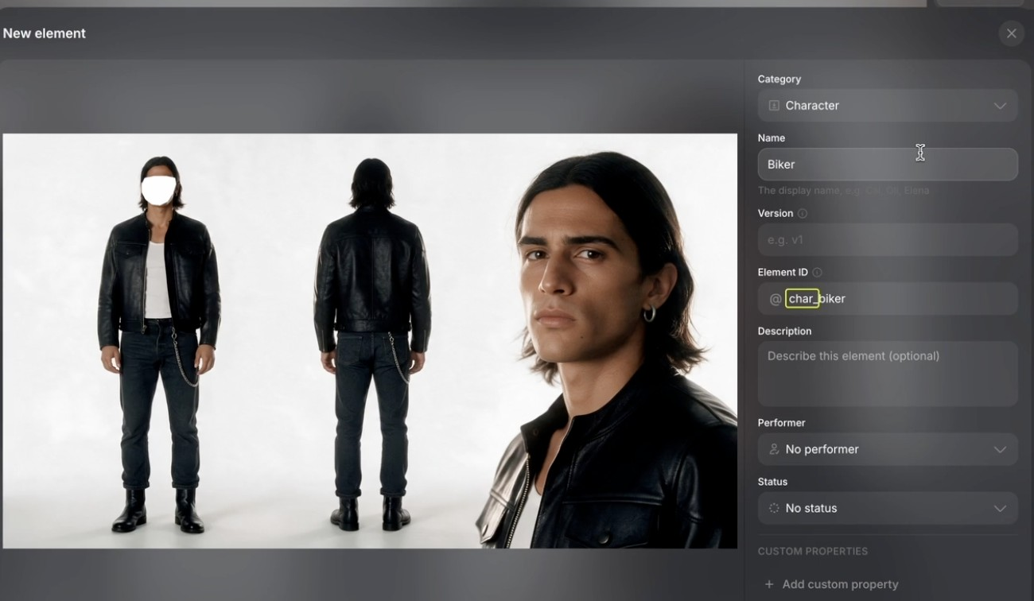
ELEMENTS · SAVE AS ELEMENT
Save once, reuse by name
Naming rule: char_, loc_, prop_ + a short slug, so the whole crew finds it
@char_biker in every prompt
One saved Element, one reference attached automatically, prompt after prompt.
The Element form
Category (Character, Location, Prop), Name, Element ID such as char_biker, description and custom properties.
© Tertiary Infotech Academy Pte Ltd
Generative AI for Video Creation · C1373
70

Slide 71
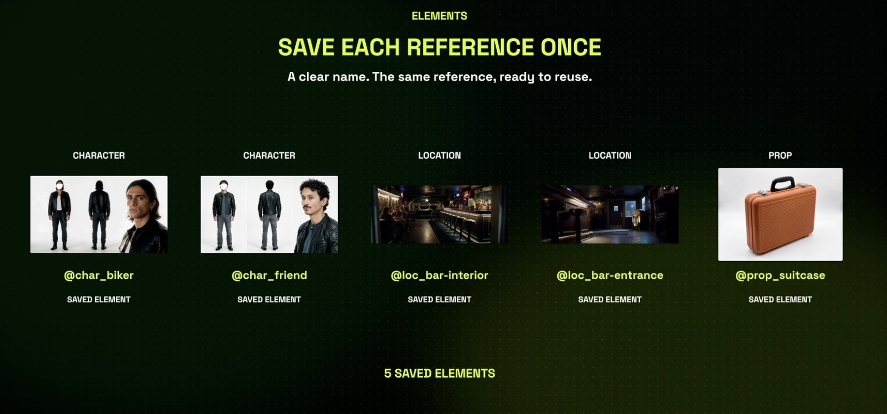
ELEMENTS · THE FINISH LINE
Five saved Elements: your cast, sets and props
What your My elements page should show at the end of the Elements lab
Characters
@char_biker, @char_friend
Locations
@loc_bar-interior, @loc_bar-entrance
Prop
@prop_suitcase, ready for every shot
© Tertiary Infotech Academy Pte Ltd
Generative AI for Video Creation · C1373
71

Slide 72
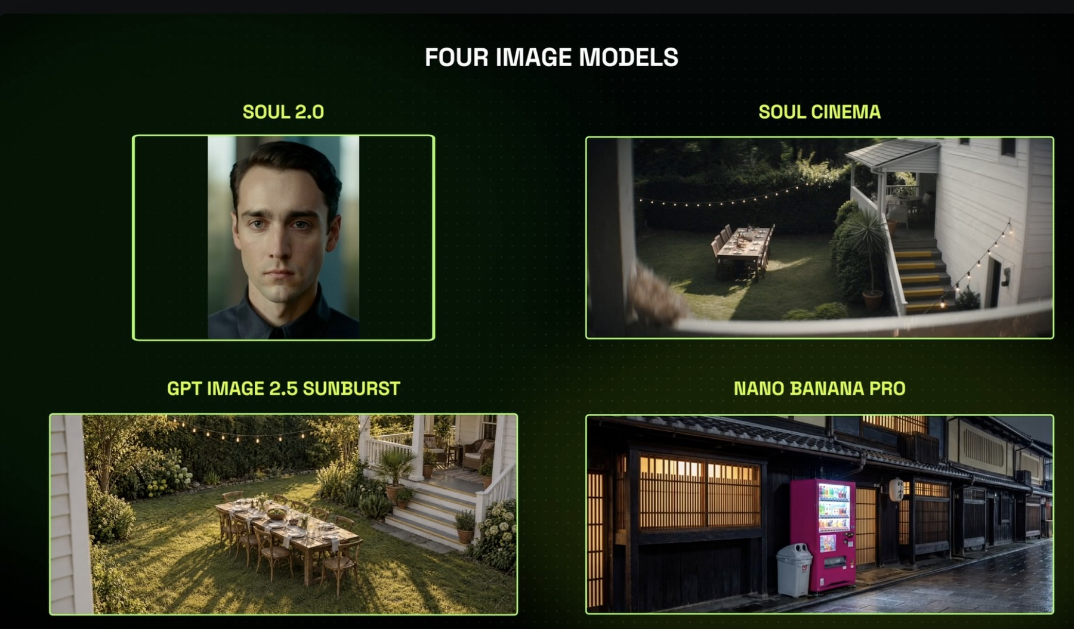
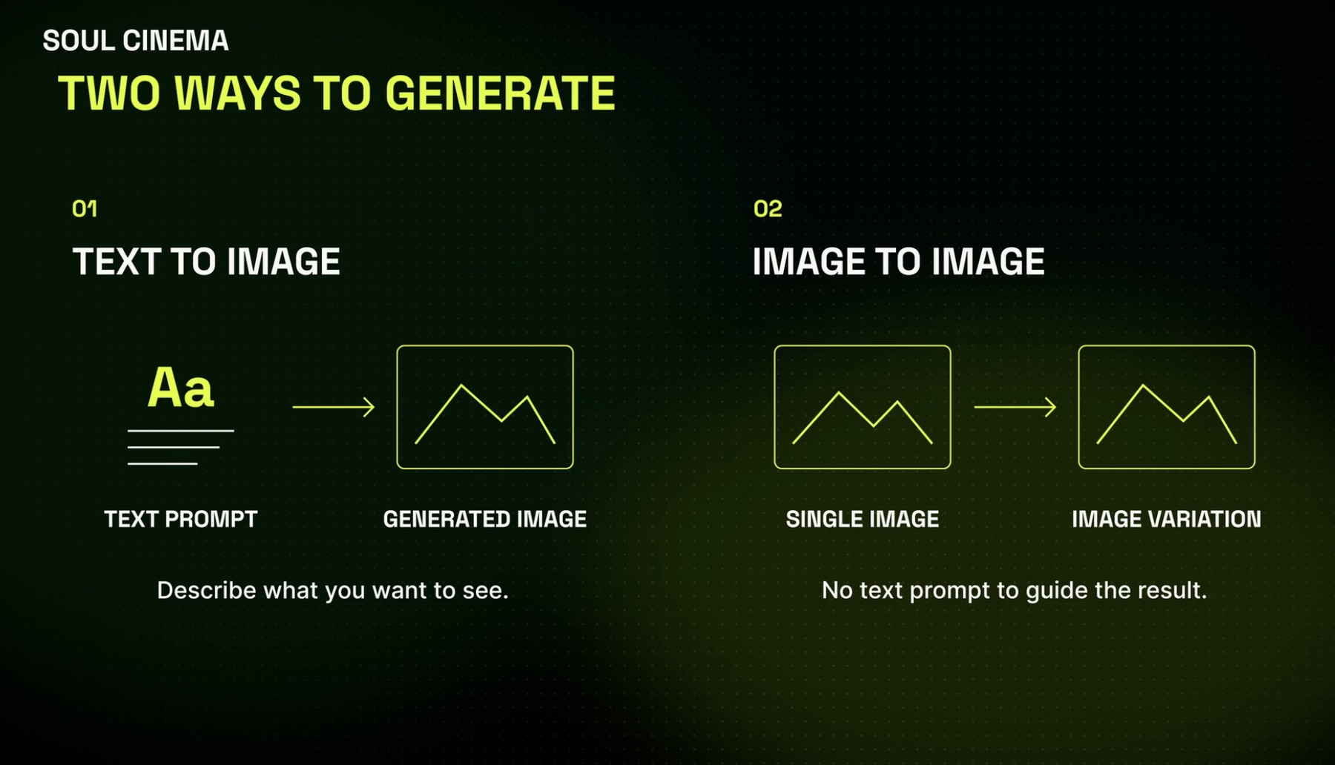
IMAGES · MODELS AND MODES
Pick the image model for the job
Elements start as images, so the image model decides the look of your film
Four image models
Soul 2.0 for people, Soul Cinema for film stills, GPT Image Sunburst for scenes, Nano Banana Pro for detailed places.
Two ways to generate
Text to image from a prompt, or image to image from a single picture to make variations.
© Tertiary Infotech Academy Pte Ltd
Generative AI for Video Creation · C1373
72

Slide 73
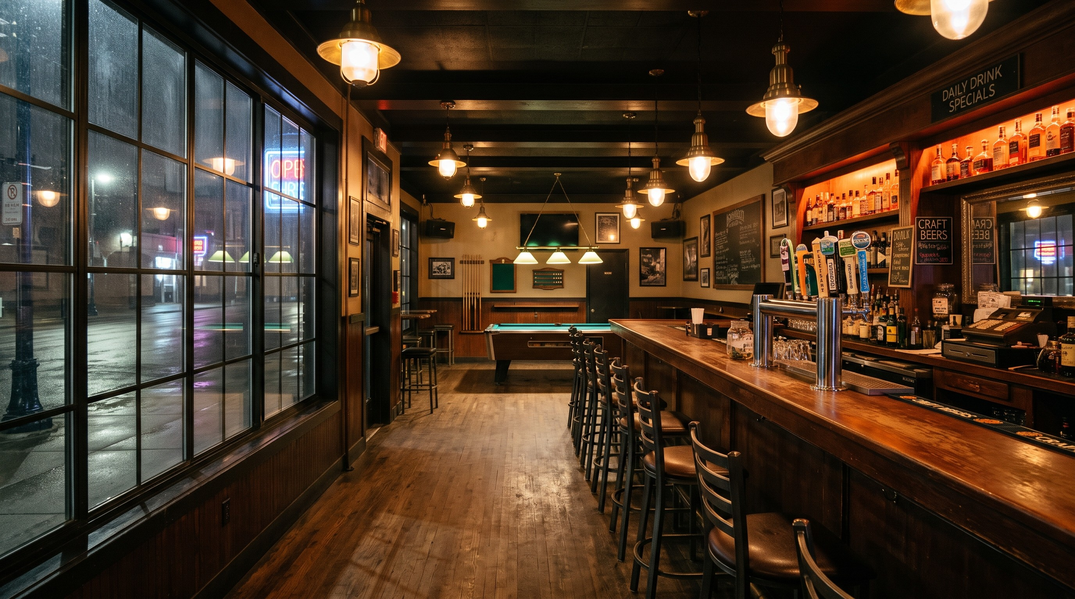
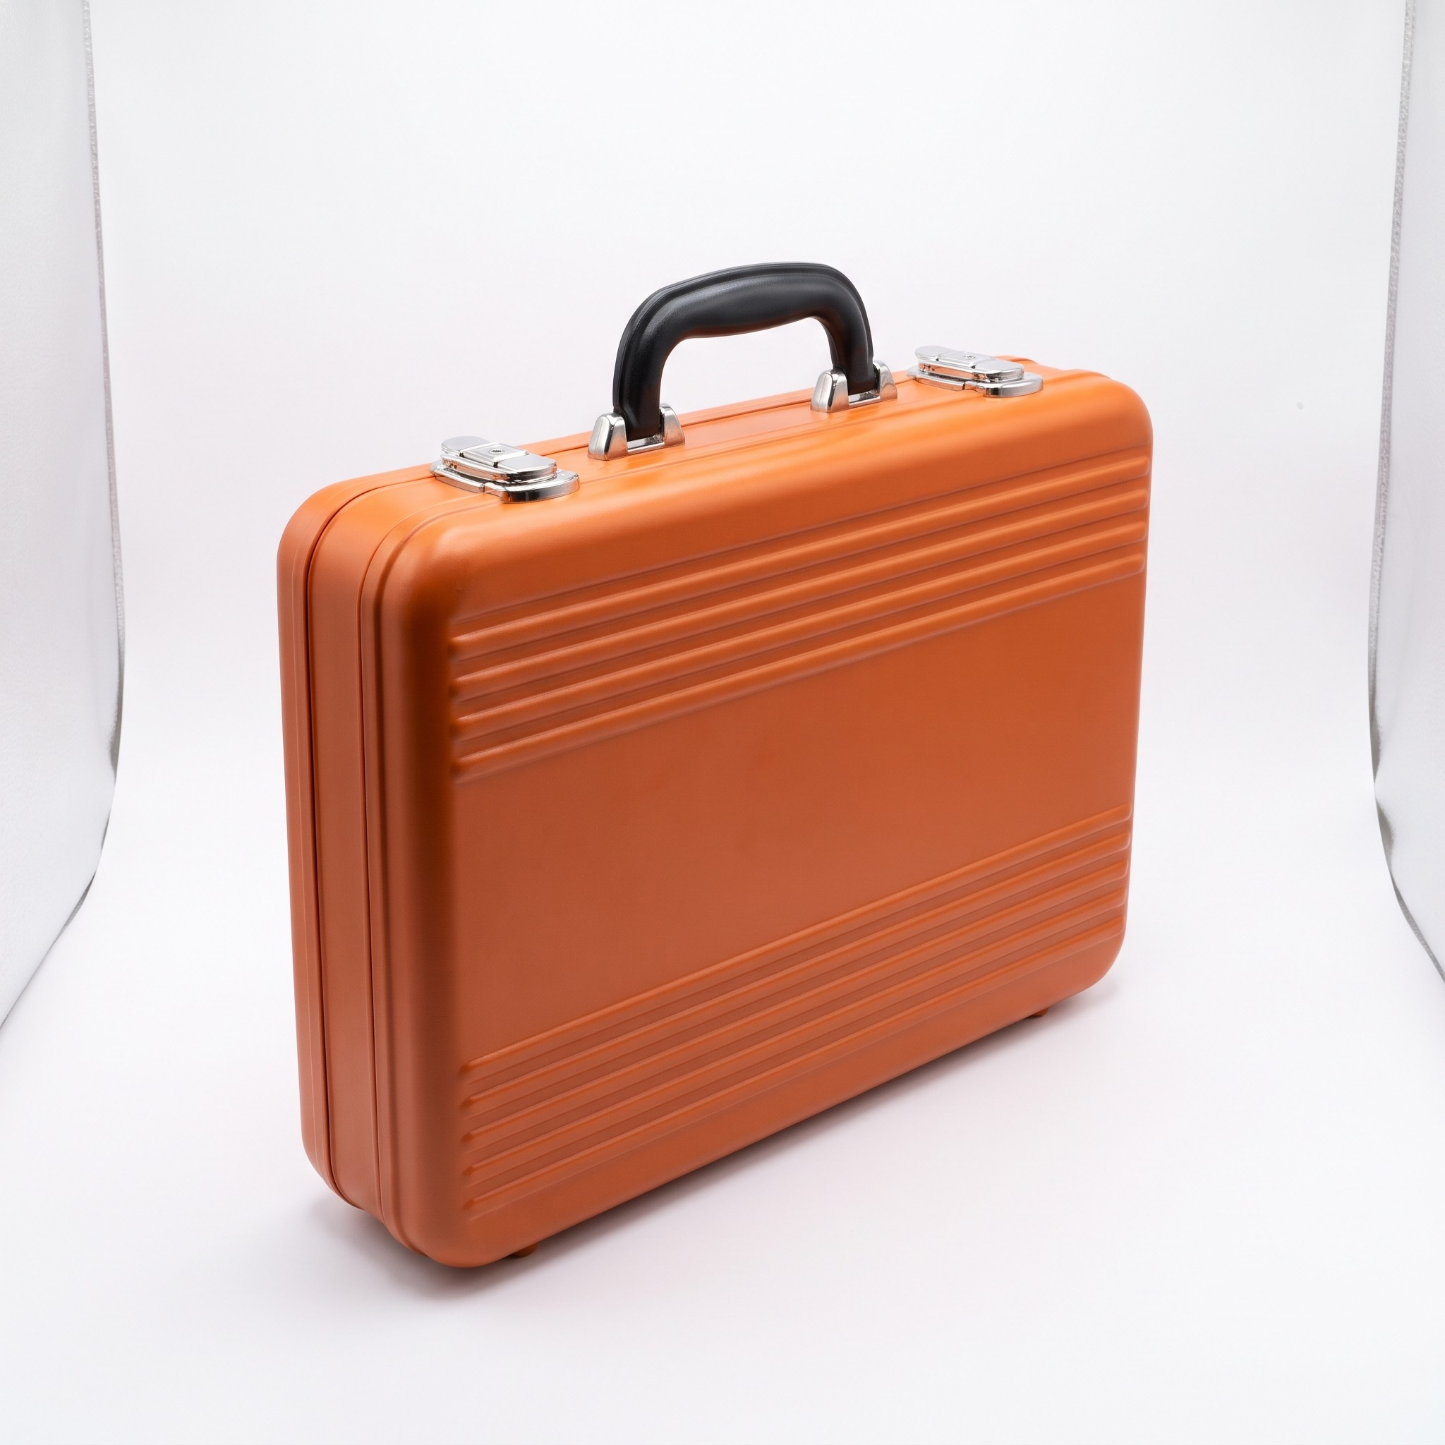
LAB 4 PREVIEW · TESTED IN HIGGSFIELD
Tested for this course: the Elements prompts work as written
Name what the shot must contain and the image model delivers it
Location prompt → the bar
Counter on the right, eight stools, pool table at the back, window on the left: every spatial anchor the prompt named. About 2 credits.
Prop prompt → the case
Slim orange ribbed lid, black handle, two metal latches, white background, no logos. About 2 credits.
© Tertiary Infotech Academy Pte Ltd
Generative AI for Video Creation · C1373
73
Notes:
Generated 9 Nov 2026 with the exact Lab 4 prompts. The same images ship in labs/lab-04…/assets as samples.

Slide 74
TOPIC 02 · HANDS-ON
Build Your Elements: Characters, Locations and Props
LAB 4
MAPS TO solutions that rectify quality issues (consistency); review footage for improvement
Faces that change between shots are the commonest AI video defect. Fix it before you shoot: cast a character with Supercomputer, turn the pick into a reference sheet, build a location and a prop, and save each one as an Element with an @handle you can call in any prompt.
You'll build
Five saved Elements, two characters, two locations and one prop, each with a reference image and an @handle.
Tools: Higgsfield: Supercomputer (character-sheet skill), Soul 2.0, Seedream 5.0 Pro, Nano Banana Pro, Elements
© Tertiary Infotech Academy Pte Ltd
Generative AI for Video Creation · C1373
74

Slide 75
LAB 4 · HOW IT RUNS — FULL STEPS IN THE LEARNER GUIDE
How Lab 4 Runs
1
2
3
4
5
Cast five options
Pick and build a sheet
Edit one detail
Build location + prop
Save as @Elements
© Tertiary Infotech Academy Pte Ltd
Generative AI for Video Creation · C1373
75

Slide 76
LAB 4 · COPY-AND-ADAPT PROMPTS
Lab 4 — Prompts (1/2)
PROMPT — CAST A CHARACTER (SUPERCOMPUTER)
Main character in a biker road movie, 25 years old, modern style clothing.
Use the character-sheet skill. Show me five photoreal casting options first; I will pick one before you build the reference sheet.
PROMPT — EDIT ONE DETAIL, KEEP IT CONSISTENT
Give him a silver wallet chain hanging off his jeans pocket. Replace the black t-shirt with a plain white ribbed cotton tank top, same tank top in all views.
© Tertiary Infotech Academy Pte Ltd
Generative AI for Video Creation · C1373
76

Slide 77
LAB 4 · COPY-AND-ADAPT PROMPTS
Lab 4 — Prompts (2/2)
PROMPT — LOCATION WITH SPATIAL ANCHORS
Wide interior of a dim neighbourhood bar at night: long wooden counter on the right with eight black stools, beer taps and backlit bottles, a pool table at the back, warm practical lamps, one large window on the left wall. Photoreal, 16:9, no people.
PROMPT — PROP (RUN ON TWO MODELS)
A slim orange hard-shell briefcase with a ribbed moulded lid, rounded corners, a black top handle and two metal latches, white background, soft studio light, no logos or text.
© Tertiary Infotech Academy Pte Ltd
Generative AI for Video Creation · C1373
77

Slide 78
LAB 4 · VERIFY
Build Your Elements: Characters, Locations and Props
✓ Check your work
Five Elements are saved with char_/loc_/prop_ handles; the character sheet shows the same outfit in all three views, the full-body face is covered and the portrait is the one clear face; each Element has a line saying which quality issue it prevents.
Detailed step-by-step instructions: Learner Guide + the lab folder in labs/.
© Tertiary Infotech Academy Pte Ltd
Generative AI for Video Creation · C1373
78

Slide 79
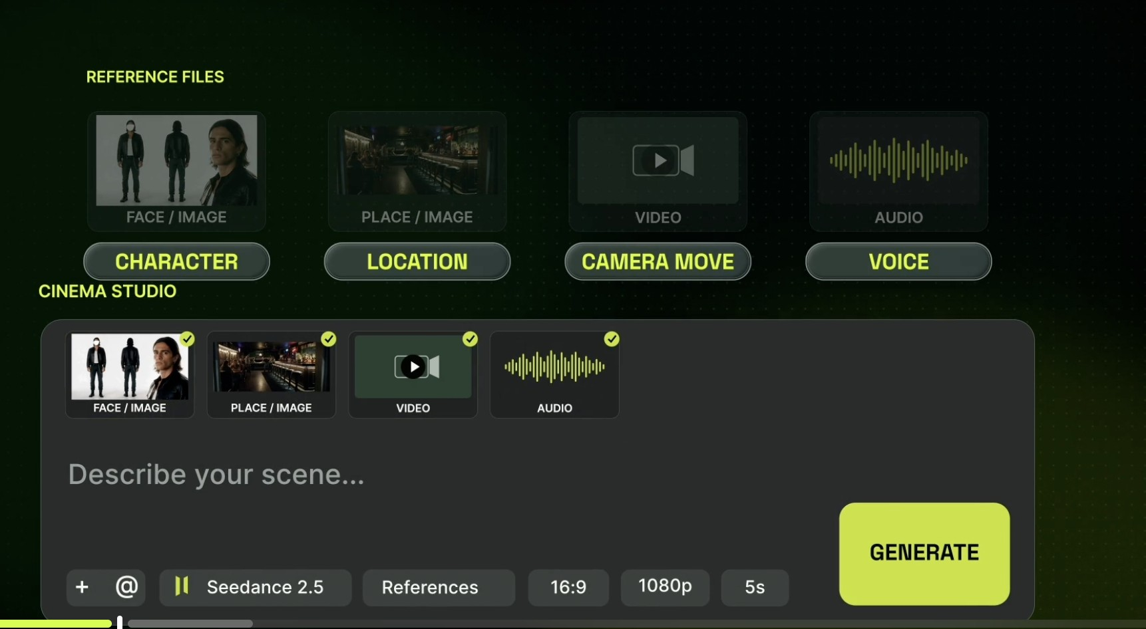
REFERENCES · ROLES
Each reference gets a job: character, location, camera, voice
A reference without a role is a suggestion; with a role it is an instruction
Face / image → Character
Who appears, exactly as shown.
Place / image → Location · video → Camera move
Where it happens, and how the camera travels.
Audio → Voice
What the character sounds like.
© Tertiary Infotech Academy Pte Ltd
Generative AI for Video Creation · C1373
79

Slide 80
REFERENCES · SEEDANCE 2.5 LIMITS
Up to fifty references in one generation
More references, fewer guesses
30
10
10
images
faces, outfits, products, places
videos
camera moves and motion to copy
audio files
voices, music, sound to match
What each image carries: a person = face + clothes; a prop = shape + colour + details; a place = space + light + colour.
© Tertiary Infotech Academy Pte Ltd
Generative AI for Video Creation · C1373
80

Slide 81
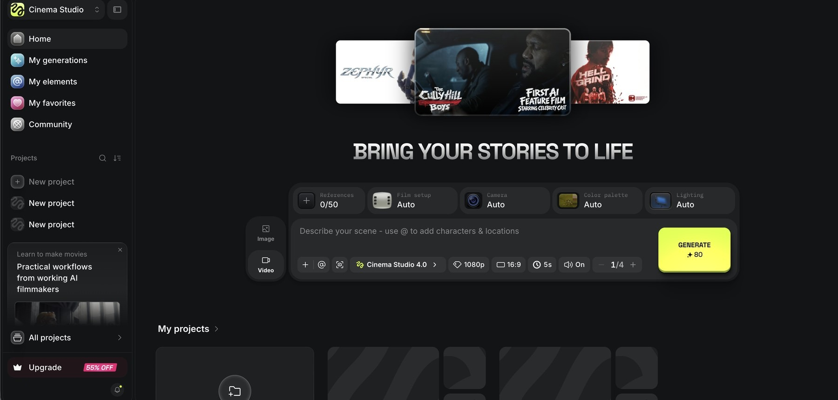
CINEMA STUDIO · THE PANEL
Cinema Studio: every control a film crew has
Set the look once, then every take inherits it
1
2
3
4
5
1
References 0/50
2
Film setup · Camera
3
Colour palette · Lighting
4
Describe your scene
5
Model and settings
Attach Elements, images, video and audio.
Camera body, lens and aperture.
The grade and the light scheme.
Type @ to drop in a saved character or location.
Cinema Studio 4.0, 1080p, 16:9, 5 s, sound, 1–4 takes; 80 credits.
© Tertiary Infotech Academy Pte Ltd
Generative AI for Video Creation · C1373
81

Slide 82
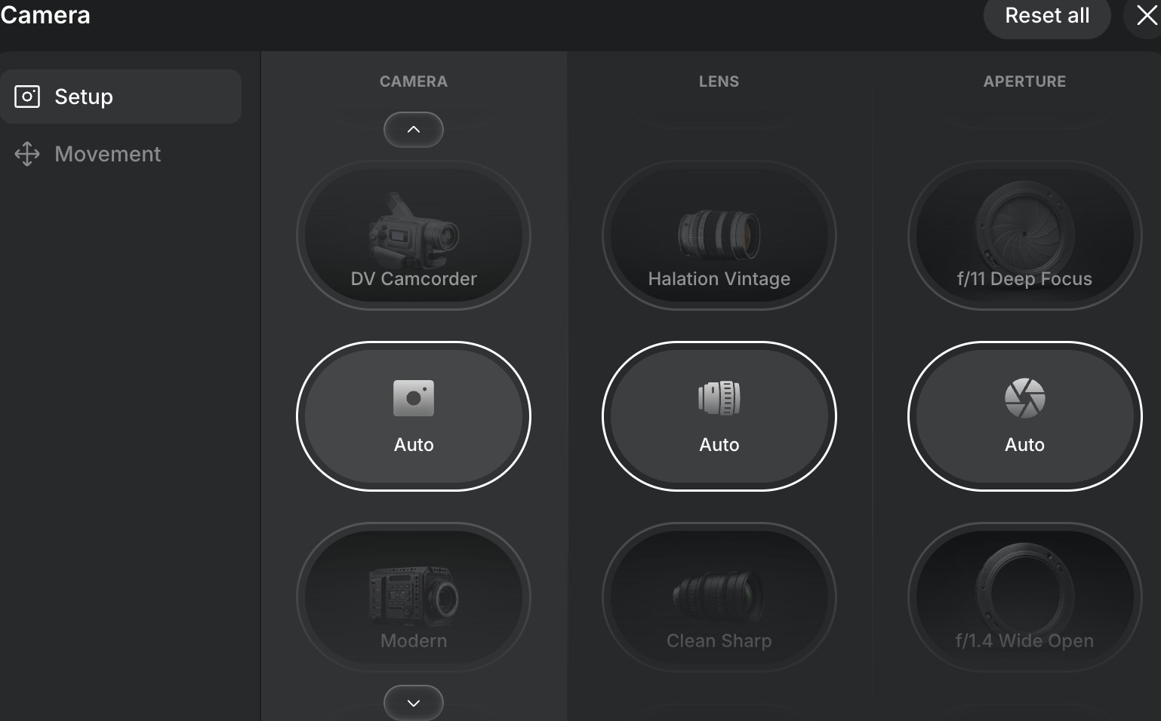
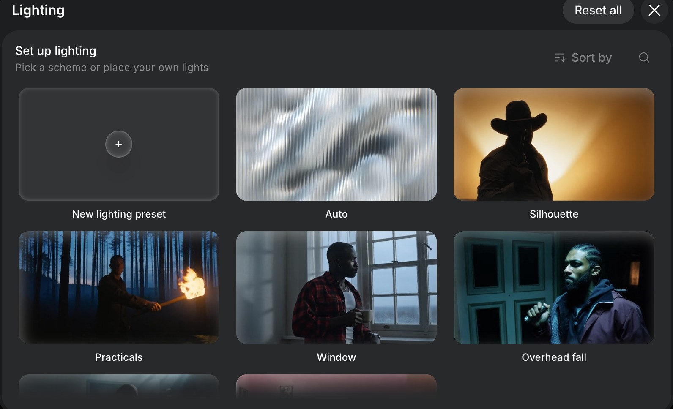
CINEMATIC EFFECTS · CAMERA + LIGHT
Set the camera and the light like a DP
Shallow focus and practical lamps make the bar feel real at night
Camera, lens, aperture, movement
DV Camcorder to Modern; Halation Vintage to Clean Sharp; f/11 deep focus to f/1.4 wide open.
Lighting presets
Auto, Silhouette, Practicals, Window, Overhead fall, or place your own lights.
© Tertiary Infotech Academy Pte Ltd
Generative AI for Video Creation · C1373
82

Slide 83
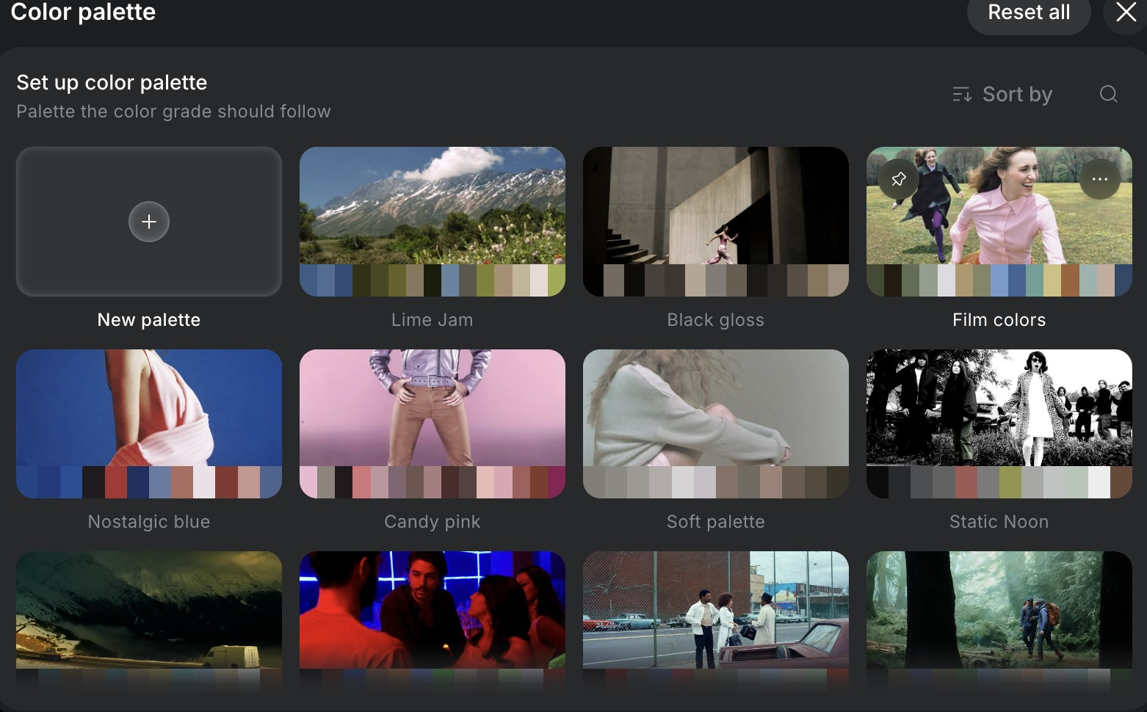
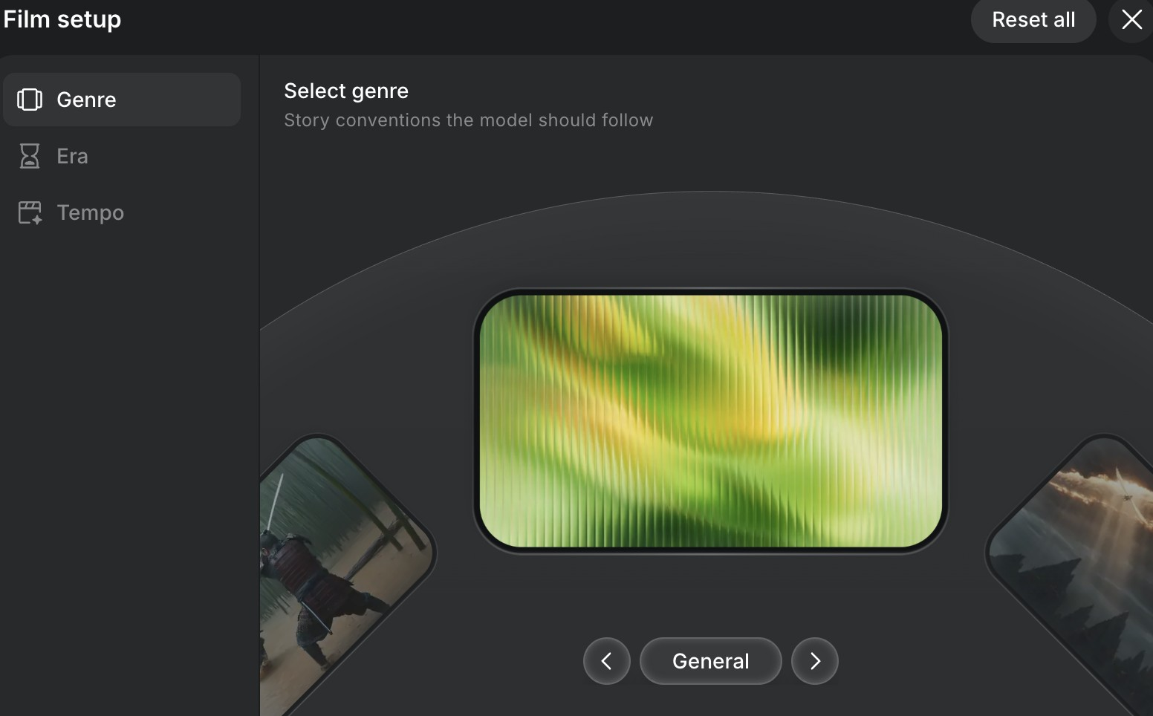
CINEMATIC EFFECTS · COLOUR + GENRE
Grade the colour and set the genre
A grade and a genre tell the model the mood in two clicks
Colour palette
Lime Jam, Black gloss, Film colors, Nostalgic blue, Candy pink, Soft palette, Static Noon, or build your own.
Genre, era, tempo
The story conventions the model should follow, the period, and the cutting pace.
© Tertiary Infotech Academy Pte Ltd
Generative AI for Video Creation · C1373
83

Slide 84
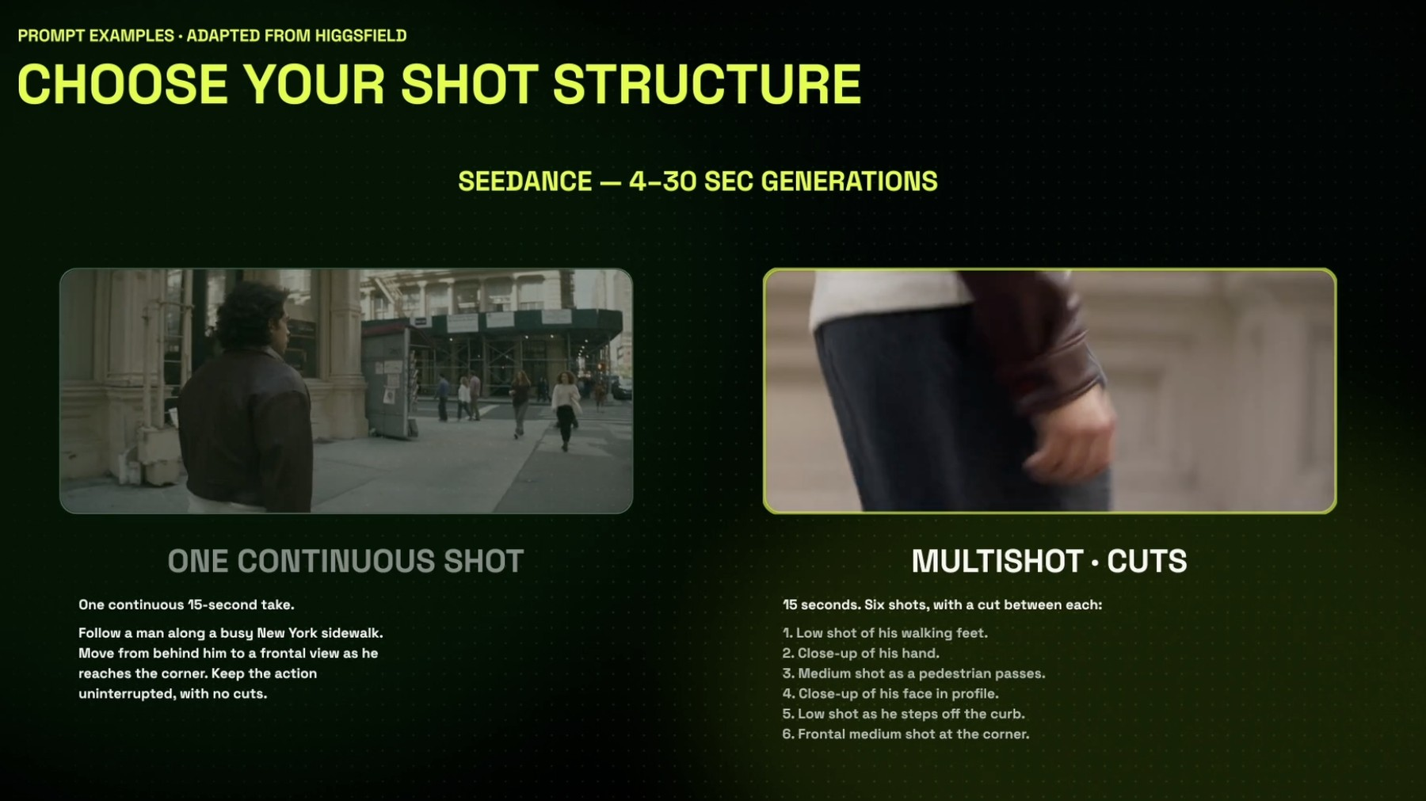
SHOTS · STRUCTURE
One continuous shot or a multishot with cuts
Decide the structure before the words: it changes every line you write
One continuous shot
'Follow a man along a busy sidewalk… frontal view at the corner… no cuts.' Good for immersion.
Multishot · cuts
'15 seconds, six shots, a cut between each': feet, hand, pedestrian pass, profile, kerb, corner.
Seedance range
4–30 seconds per generation; you choose the structure in the prompt.
© Tertiary Infotech Academy Pte Ltd
Generative AI for Video Creation · C1373
84

Slide 85
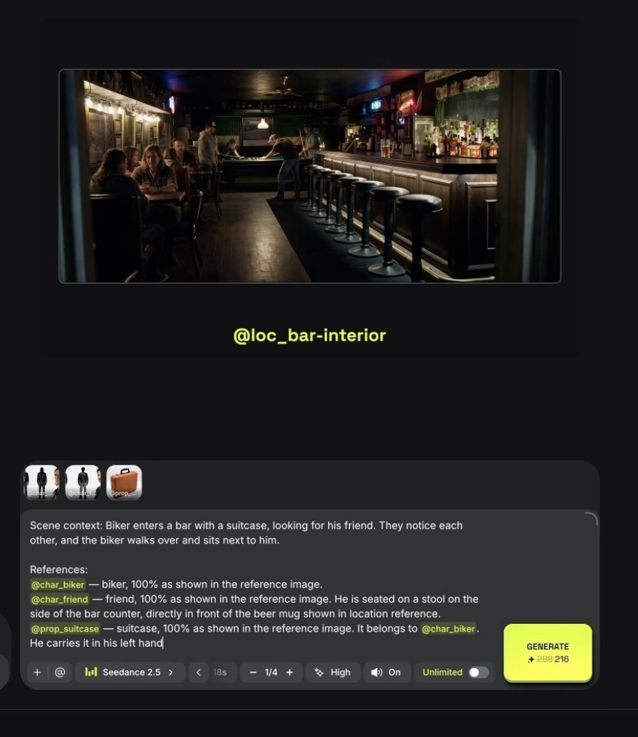
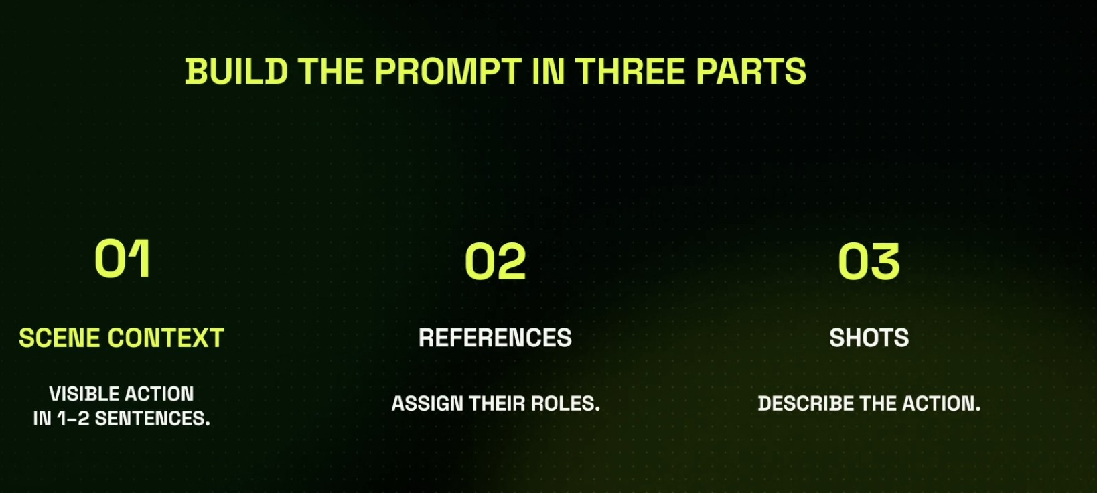
SHOTS · THE PROMPT
Write the three parts, then attach the references
Lab 5 gives you this exact bar-scene prompt to adapt
Context, references, shots
01 scene context in 1–2 sentences; 02 references and their roles; 03 the shots that describe the action.
A real prompt with @handles
@char_biker, @char_friend and @prop_suitcase each '100% as shown', with who holds what and where they sit.
© Tertiary Infotech Academy Pte Ltd
Generative AI for Video Creation · C1373
85

Slide 86
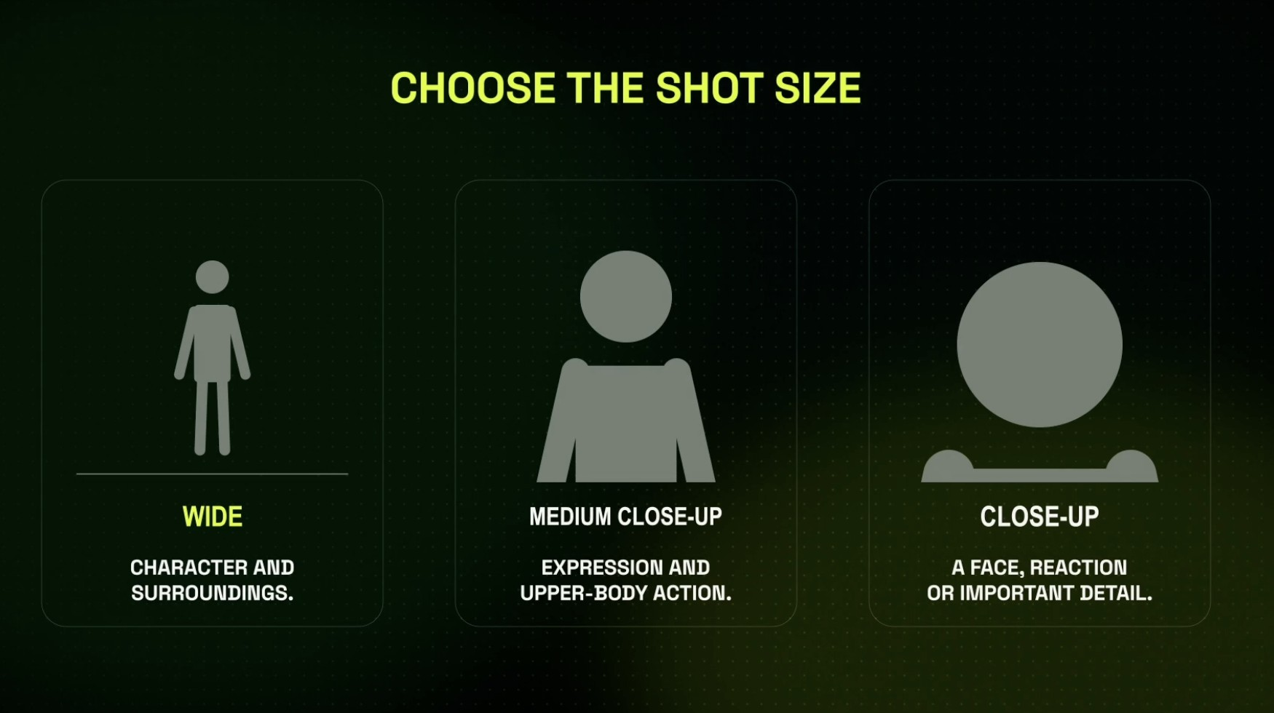
SHOTS · SIZE
Choose the shot size for what the audience must read
Every numbered shot in your prompt starts with one of these three words
Wide
Character and surroundings: where are we?
Medium close-up
Expression and upper-body action: what are they doing?
Close-up
A face, a reaction or an important detail: what do they feel?
© Tertiary Infotech Academy Pte Ltd
Generative AI for Video Creation · C1373
86

Slide 87
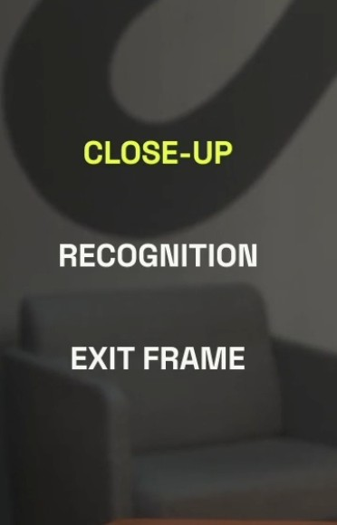
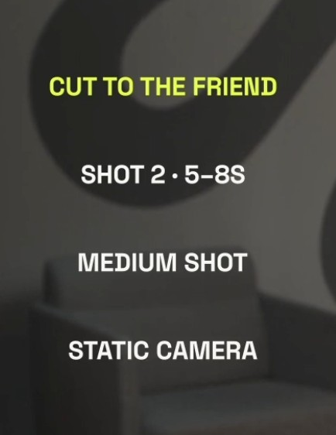
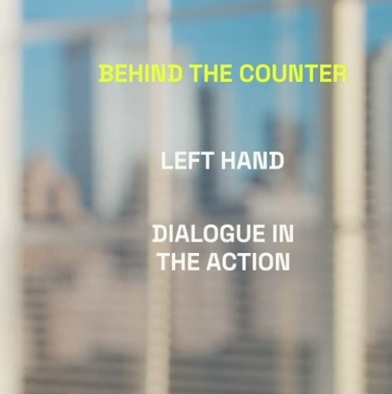
SHOTS · ANNOTATED
Write each shot as size + purpose + camera
Three shot cards from the bar scene: copy the pattern into your shot list
CLOSE-UP · recognition, exit frame
CUT TO THE FRIEND · shot 2, 5–8 s, medium, static
BEHIND THE COUNTER · left hand, dialogue in the action
Pattern: SHOT n · time · size · camera · action · the line or sound that lands in it.
© Tertiary Infotech Academy Pte Ltd
Generative AI for Video Creation · C1373
87

Slide 88
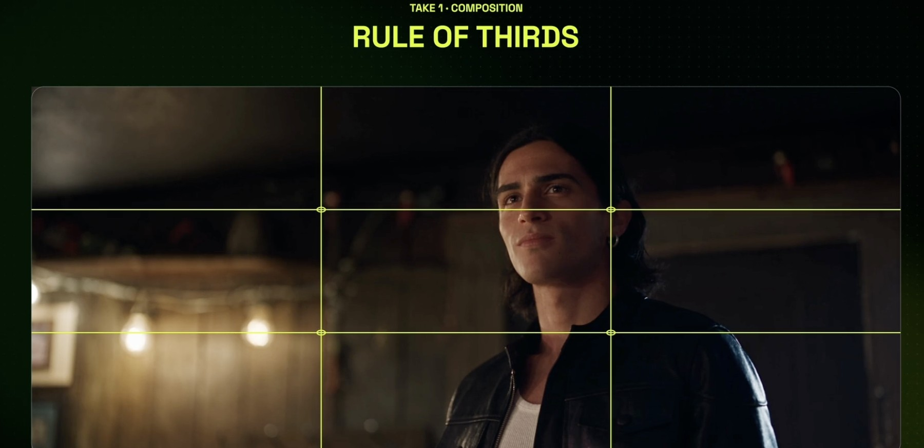
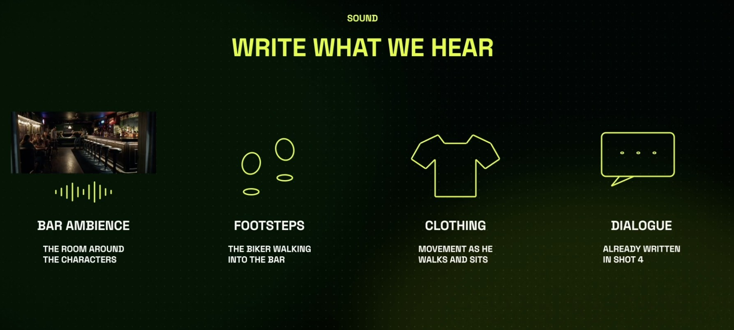
TAKES · COMPOSITION AND SOUND
Compose the frame, then write what we hear
Two lines in the prompt that separate a clip from a scene
Rule of thirds
Eyes on the upper third, the subject off-centre, space in the direction he looks.
Sound is part of the prompt
Bar ambience, footsteps, clothing movement, dialogue already written in shot 4. Seedance renders it with the picture.
© Tertiary Infotech Academy Pte Ltd
Generative AI for Video Creation · C1373
88

Slide 89
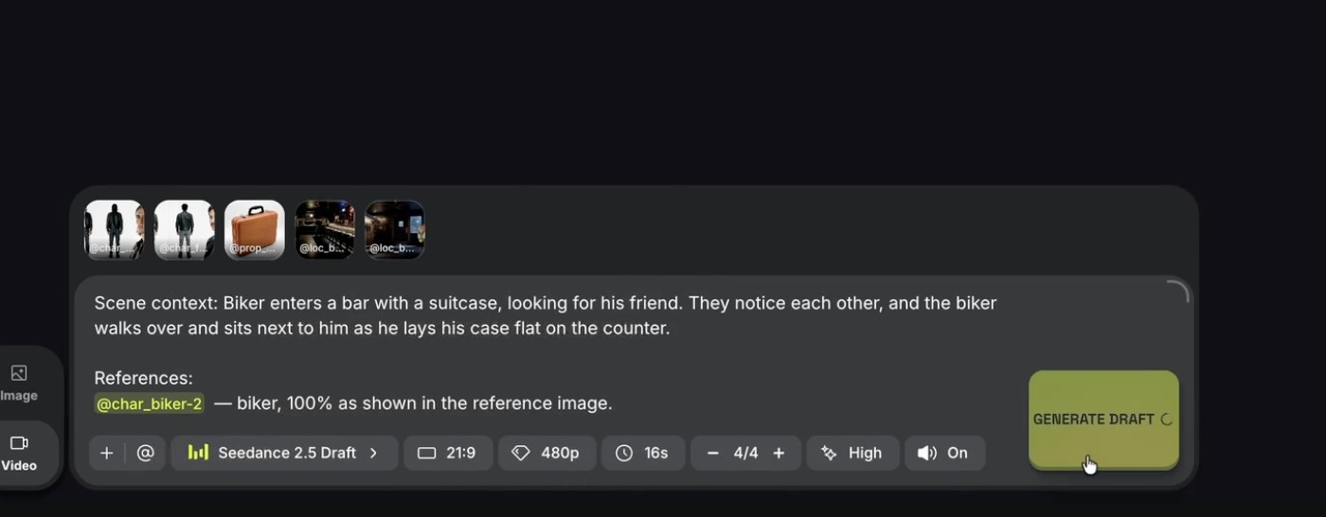
SHOTS & TAKES · DRAFT MODE
Draft mode: four test takes for the price of one final
Explore at 480p, commit at 1080p
1
2
4
3
1
References attached
2
Three-part prompt
3
Seedance 2.5 Draft
4
Generate Draft
Characters, prop and both bar locations.
Scene context, references with roles, shots.
480p, 21:9, 16 s, 4 takes, sound on.
About 45 credits a take for 15 s; review before you spend more.
© Tertiary Infotech Academy Pte Ltd
Generative AI for Video Creation · C1373
89

Slide 90
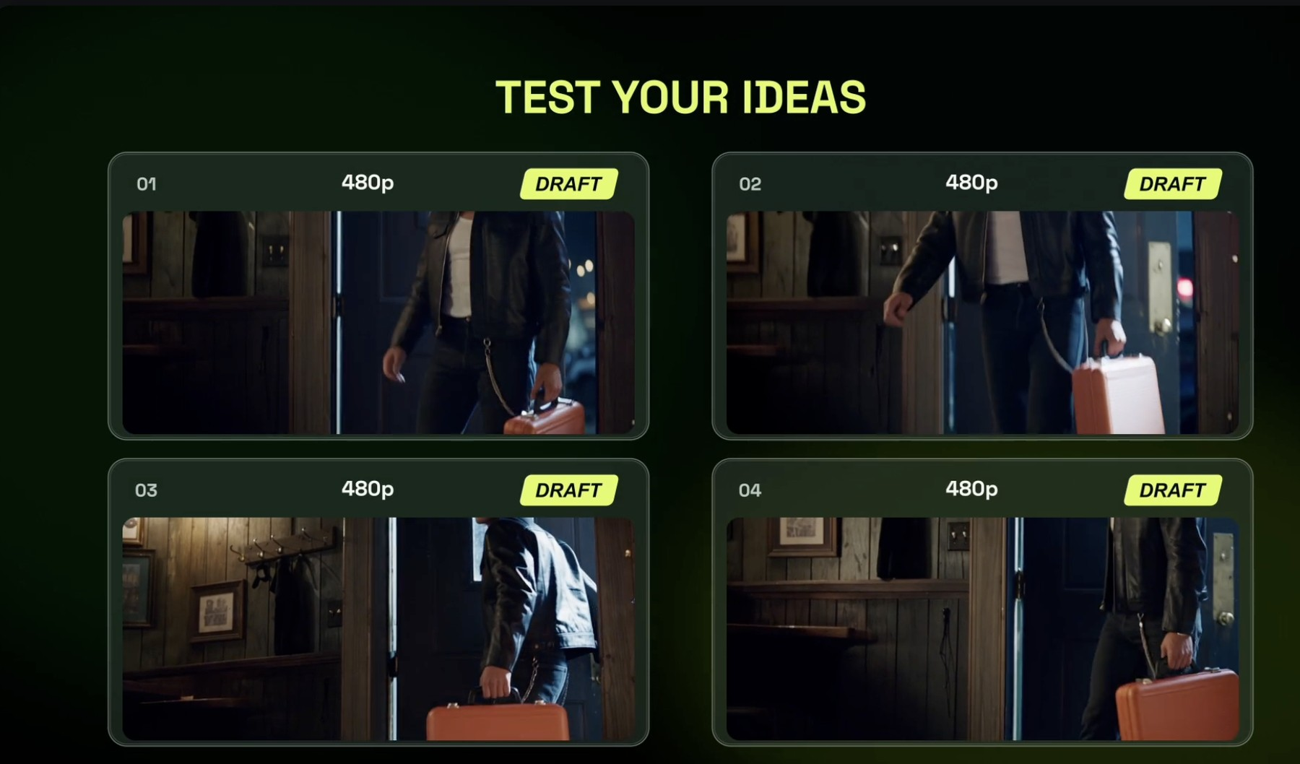
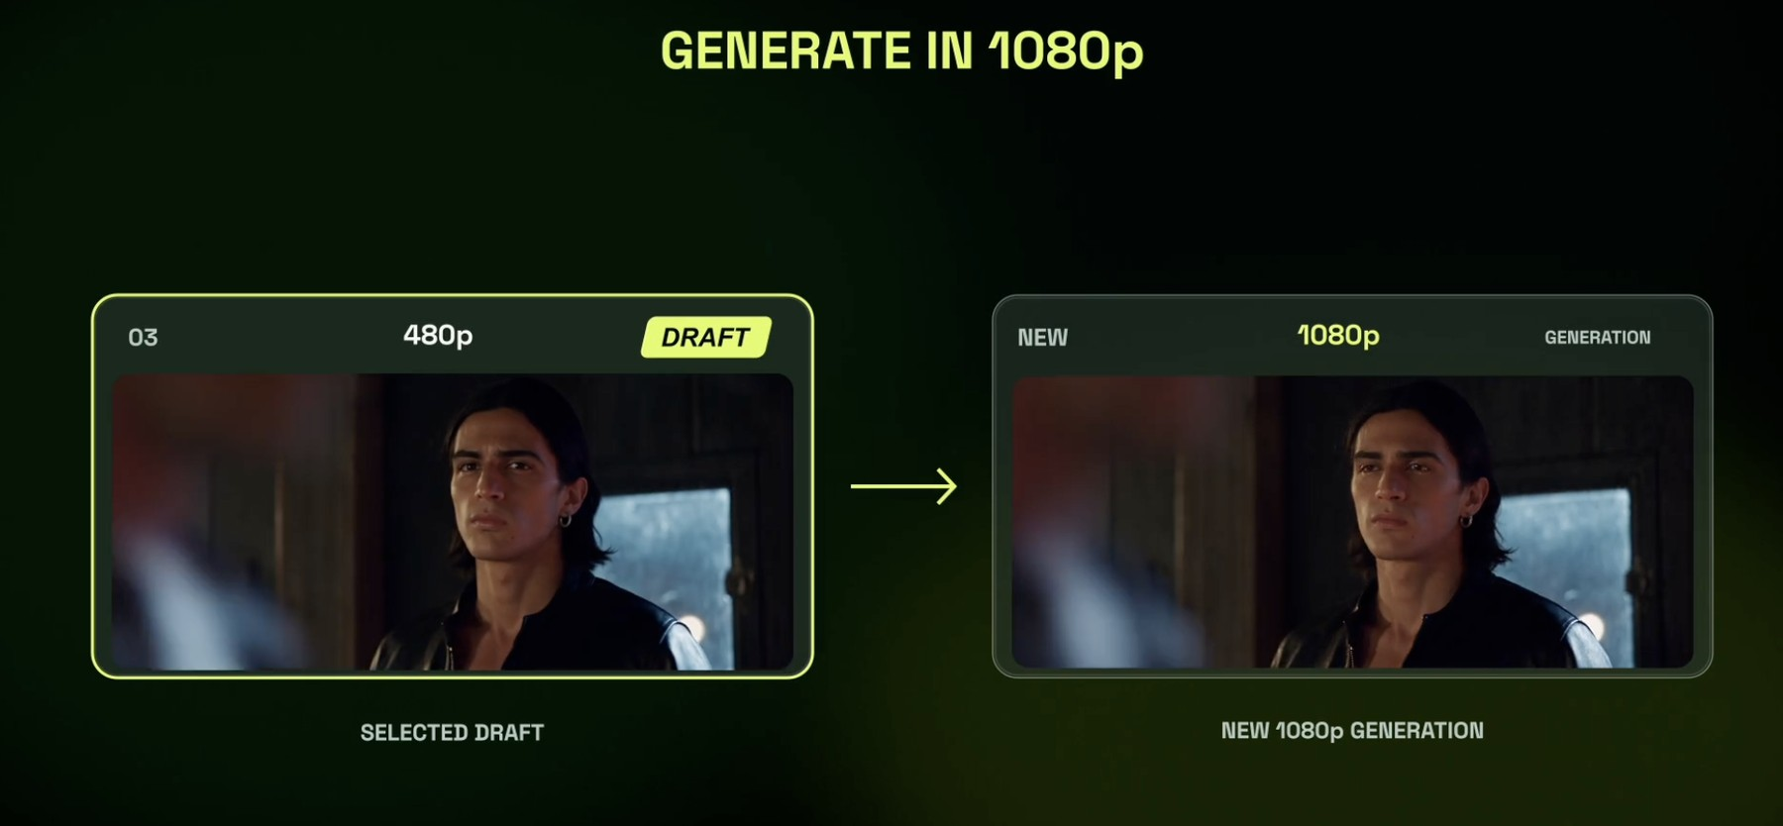
SHOTS & TAKES · DRAFT → FINAL
Test four ideas, finalise one
Drafts can be finalised within seven days
Four 480p Drafts
Same prompt, four takes. Compare the walk, the case and the light.
Generate the keeper in 1080p
The selected Draft is re-rendered at full resolution: same take, full quality.
© Tertiary Infotech Academy Pte Ltd
Generative AI for Video Creation · C1373
90

Slide 91
TOPIC 02 · HANDS-ON
Direct Shots and Takes in Cinema Studio
LAB 5
MAPS TO review footage to improve storytelling; solutions to rectify quality issues
Direct a 15-second bar scene the way a film crew would: attach your Elements as references with roles, set camera, lens, lighting and colour, write the shots and the sound, then render four 480p Draft takes. Finalise only the best take in 1080p.
You'll build
Four Draft takes of one scene and one 1080p final of the best take, made from your Elements.
Tools: Higgsfield: Cinema Studio, Seedance 2.5 / Seedance 2.5 Draft, References, Elements
© Tertiary Infotech Academy Pte Ltd
Generative AI for Video Creation · C1373
91

Slide 92
LAB 5 · HOW IT RUNS — FULL STEPS IN THE LEARNER GUIDE
How Lab 5 Runs
1
2
3
4
5
Attach references with roles
Set camera, light, colour
Write context, shots, sound
Render 4 Draft takes
Finalise the best in 1080p
© Tertiary Infotech Academy Pte Ltd
Generative AI for Video Creation · C1373
92

Slide 93
LAB 5 · COPY-AND-ADAPT PROMPTS
Lab 5 — Prompts (1/2)
PROMPT — BAR SCENE — THREE-PART PROMPT (SEEDANCE 2.5)
Scene context: Biker enters a bar with a suitcase, looking for his friend. They notice each other, and the biker walks over and sits next to him as he lays his case flat on the counter.
References:
@char_biker — biker, 100% as shown in the reference image.
@char_friend — friend, 100% as shown in the reference image. He is seated on a stool on the side of the bar counter.
@prop_suitcase — suitcase, 100% as shown in the reference image. It belongs to @char_biker. He carries it in his left hand.
@loc_bar-interior — the bar, 100% as shown in the location reference.
Shots (cut between each):
1. 0–3s: wide, the biker pushes through the door, suitcase in his left hand.
2. 3–6s: medium shot, the friend looks up from his beer. Static camera.
3. 6–9s: close-up, the biker recognises him.
4. 9–12s: medium close-up, the biker sits; dialogue: "Told you I'd make it."
5. 12–15s: close-up, he lays the case flat on the counter.
Sound: bar ambience, footsteps, leather jacket movement, the line of dialogue.
© Tertiary Infotech Academy Pte Ltd
Generative AI for Video Creation · C1373
93

Slide 94
LAB 5 · COPY-AND-ADAPT PROMPTS
Lab 5 — Prompts (2/2)
PROMPT — ONE CONTINUOUS SHOT (COMPARE)
One continuous 15-second take. Follow a man along a busy New York sidewalk. Move from behind him to a frontal view as he reaches the corner. Keep the action uninterrupted, with no cuts.
© Tertiary Infotech Academy Pte Ltd
Generative AI for Video Creation · C1373
94

Slide 95
LAB 5 · VERIFY
Direct Shots and Takes in Cinema Studio
✓ Check your work
All four Drafts use your Elements; your take log scores each take; the 1080p final is the take you scored best and keeps the same faces, prop and bar.
Detailed step-by-step instructions: Learner Guide + the lab folder in labs/.
© Tertiary Infotech Academy Pte Ltd
Generative AI for Video Creation · C1373
95

Slide 96
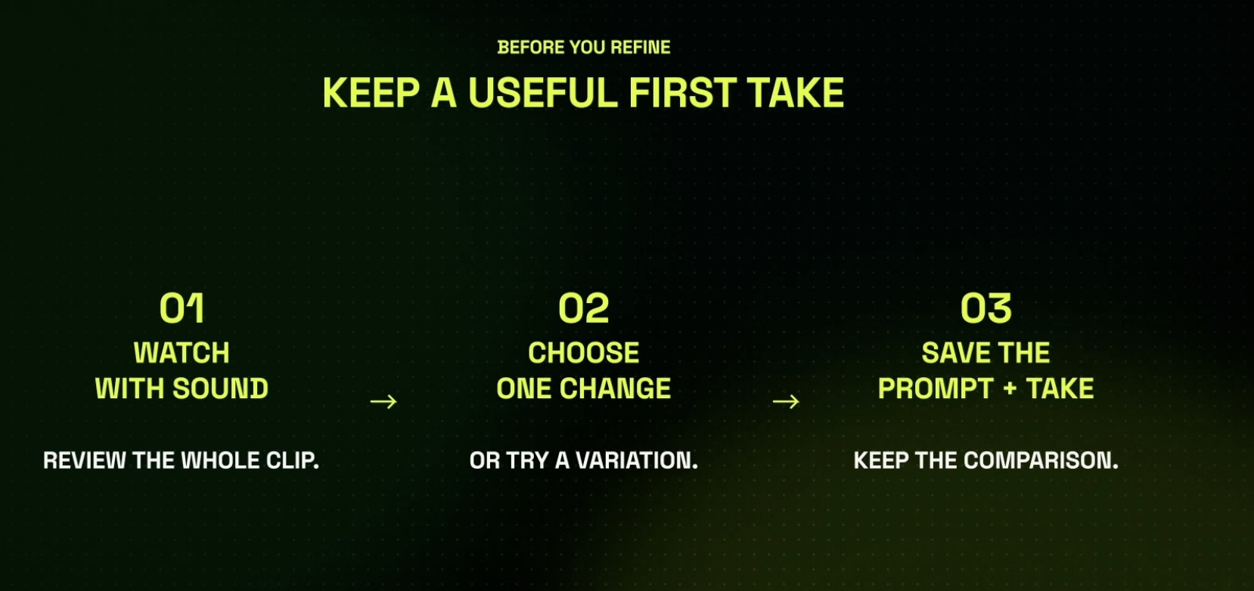
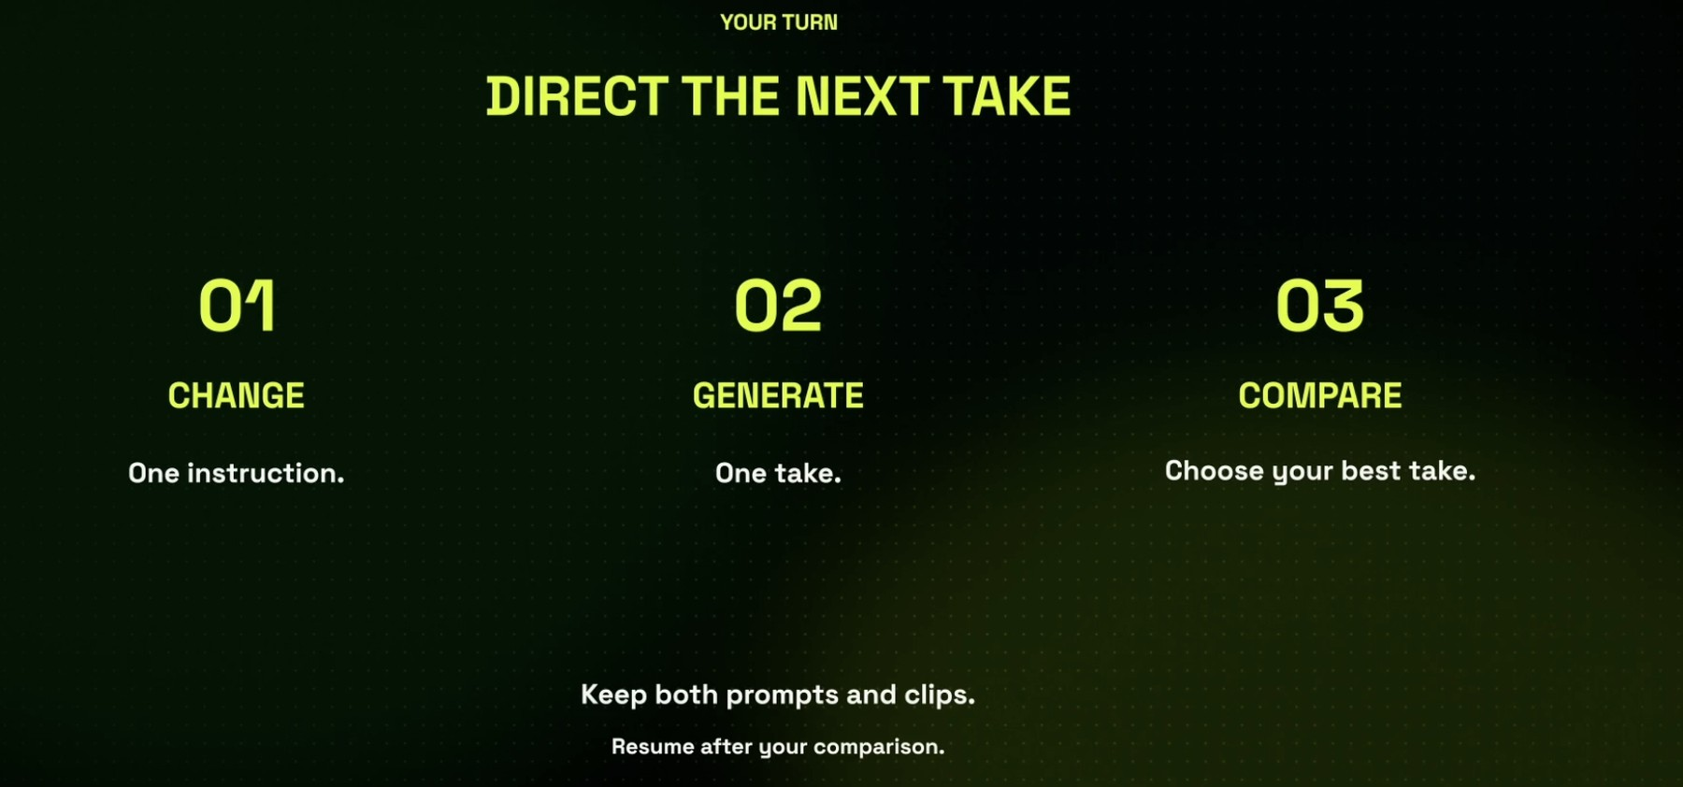
TAKES · THE DIRECTOR'S LOOP
Keep a useful first take, then direct the next one
A take is a decision you can undo; a deleted take is a lesson lost
Before you refine
Watch with sound, choose ONE change or a variation, save the prompt and the take so you can compare.
Direct the next take
Change one instruction, generate one take, compare, choose. Keep both prompts and clips.
© Tertiary Infotech Academy Pte Ltd
Generative AI for Video Creation · C1373
96

Slide 97

ASSESS THE FOOTAGE
Continuity: check the prop through the whole scene
Prop teleport is the defect viewers spot first
Where?
Its position in each shot.
Who holds it?
The right character, the right hand.
Same?
Colour, shape and size from shot to shot.
© Tertiary Infotech Academy Pte Ltd
Generative AI for Video Creation · C1373
97

Slide 98
FROM DEFECT TO FIX
Quality issues → the Higgsfield fix
Issue
Typical cause
Fix in Higgsfield
Face changes between shots
No character reference
Character Element + sheet
Set changes between shots
No location reference
Location Element with anchors
Prop swaps hands or vanishes
Holder not stated
'@prop… belongs to @char…, left hand'
Wrong object in the shot
Model guessed
Genjutsu Replace Object
Soft, low-res final
480p Draft exported
Finalise at 1080p or Upscale
Wrong ratio for TikTok
16:9 master only
Reframe to 9:16
TIP: Learn each issue together with its matching Higgsfield fix.
© Tertiary Infotech Academy Pte Ltd
Generative AI for Video Creation · C1373
98

Slide 99
SCORE EVERY CUT BEFORE EXPORT
Parameters to assess AI video quality
Resolution & sharpness
1080p minimum for social; no 480p Draft in the final.
Motion & physics
No melting hands, sliding feet or stutter at cuts.
1
2
Continuity
Faces, clothes, props and sets match shot to shot.
Audio
Dialogue clear above music; foley matches the action.
3
4
Captions & pacing
Accurate, in sync, readable; cuts on the beat.
Compliance
Platform specs, AI label, consent, rights.
5
6
© Tertiary Infotech Academy Pte Ltd
Generative AI for Video Creation · C1373
99

Slide 100
TOPIC 02 · HANDS-ON
Cut, Caption and Assess the Scene
LAB 6
MAPS TO review edited footage to improve storytelling; assess footage against technical and legal requirements; quality parameters
Keep the useful first take, direct one more, then have Supercomputer assemble the takes into a captioned cut with a soundtrack. Score the cut against the quality parameters and your Lab 3 standards before anything is exported.
You'll build
A captioned 15–30 s cut in 16:9 and 9:16 with a scored quality checklist and a list of storytelling improvements.
Tools: Higgsfield: Cinema Studio, Supercomputer (video montage: trims, soundtrack, burned captions)
© Tertiary Infotech Academy Pte Ltd
Generative AI for Video Creation · C1373
100

Slide 101
LAB 6 · HOW IT RUNS — FULL STEPS IN THE LEARNER GUIDE
How Lab 6 Runs
1
2
3
4
5
Keep a useful first take
Direct one change
Continuity check
Assemble, caption, soundtrack
Score against the checklist
© Tertiary Infotech Academy Pte Ltd
Generative AI for Video Creation · C1373
101

Slide 102
LAB 6 · COPY-AND-ADAPT PROMPTS
Lab 6 — Prompts
PROMPT — DIRECT ONE CHANGE
Keep everything in this take the same. Change one thing only: in shot 3 make the camera push in slowly on the biker's face as he recognises his friend, and add a beat of silence before the dialogue.
PROMPT — ASSEMBLE, CAPTION AND SCORE (SUPERCOMPUTER)
Assemble these two clips into one 20-second cut: take 2 first, then shots 4–5 of take 1. Trim dead frames at each cut.
Add a moody low-tempo soundtrack under the bar ambience, keep the dialogue clearly above the music.
Burn captions for the dialogue: white, bottom third, two lines max. Export 16:9 and 9:16.
Then score the cut against: resolution, motion, face/prop continuity, audio, captions, pacing, platform compliance. Table, pass/fail.
© Tertiary Infotech Academy Pte Ltd
Generative AI for Video Creation · C1373
102

Slide 103
LAB 6 · VERIFY
Cut, Caption and Assess the Scene
✓ Check your work
The checklist scores every parameter with a reason, the cut exports in both ratios with readable captions, and you name three storytelling improvements tied to specific shots.
Detailed step-by-step instructions: Learner Guide + the lab folder in labs/.
© Tertiary Infotech Academy Pte Ltd
Generative AI for Video Creation · C1373
103

Slide 104
TOPIC RECAP · WHAT YOU CAN NOW DO
Recap — Improve Video Footage on GAI Powered Video Platforms
Lab 4 — Build Your Elements: Characters, Locations and Props
You built: Five saved Elements, two characters, two locations and one prop, each with a reference image and an @handle.
4
Lab 5 — Direct Shots and Takes in Cinema Studio
You built: Four Draft takes of one scene and one 1080p final of the best take, made from your Elements.
5
Lab 6 — Cut, Caption and Assess the Scene
You built: A captioned 15–30 s cut in 16:9 and 9:16 with a scored quality checklist and a list of storytelling improvements.
6
© Tertiary Infotech Academy Pte Ltd
Generative AI for Video Creation · C1373
104

Slide 105
TOPIC 3
1
Lab 7 — Fix What Fails: Remedial Actions in Higgsfield
Apply new AI technologies to Improve Video Production
2
Lab 8 — Add Voice, Music and Cinematic Effects
3
Lab 9 — Use-Case Sprint: One Product Photo to a Published 15-Second Ad
4
Lab 10 — Mini Capstone: Direct Your Own 15-Second Video in Higgsfield
Remove & replace objects · cinematic effects · upscale · voice & music · models compared · publish
© Tertiary Infotech Academy Pte Ltd
Generative AI for Video Creation · C1373
105

Slide 106
KEY CONCEPTS
Key Concepts — Topic 3
Remove & replace
Genjutsu Replace Object swaps a product, prop or garment in finished footage, keeping the motion.
Cinematic effects
Lighting presets, colour grades and viral effect presets add VFX without a compositor.
1
2
Enhance shots
Upscale to 1080p or 4K, reframe 16:9 to 9:16, regenerate only the broken shot.
Voice & music
Native Seedance audio, a cloned voice for narration and a generated soundtrack.
3
4
Models compared
Seedance 2.5, Kling 4.0, Cinema Studio 4.0 and Genjutsu: pick per shot on quality, cost and control.
Publish responsibly
Export per platform, label synthetic media, clear consent, then share to TikTok or YouTube.
5
6
© Tertiary Infotech Academy Pte Ltd
Generative AI for Video Creation · C1373
106

Slide 107
WHAT YOU'LL DO
Hands-On Labs — Topic 3
7
Lab 7 — Fix What Fails: Remedial Actions in Higgsfield
A remediated cut with a before/after checklist and a remedy table (issue, cause, Higgsfield fix, result).
8
Lab 8 — Add Voice, Music and Cinematic Effects
Your scene with a generated soundtrack, a voiceover line and one cinematic effect, plus a rated technology evaluation.
9
Lab 9 — Use-Case Sprint: One Product Photo to a Published 15-Second Ad
A 15-second ad (16:9 and 9:16) made from one product photo, a two-model comparison, and a publish-ready post.
10
Lab 10 — Mini Capstone: Direct Your Own 15-Second Video in Higgsfield
Your own 15-second video (MP4, 1080p) with a capstone scorecard, a remedy table and screenshots of your prompt, takes and fixes.
© Tertiary Infotech Academy Pte Ltd
Generative AI for Video Creation · C1373
107

Slide 108
REMEDIAL ACTIONS
Remedial actions: from FAIL to fixed
Fails the check
Remedial action
Higgsfield tool
Wrong or drifting object
Swap it, keep the motion
Genjutsu Replace Object
One broken shot
Regenerate that shot only, same Elements
Cinema Studio
Soft or 480p footage
Upscale or finalise the Draft
Upscale · Seedance 2.5
16:9 only, TikTok needs 9:16
Reframe with a safe area
Reframe
Muddy or wrong sound
Rewrite the Sound line, regenerate
Seedance native audio
No AI label / no consent
Add label, record consent
Publish settings
TIP: Order fixes cheapest first: a sound-line rewrite on Draft costs 45 credits; a full 1080p re-shoot costs 240.
© Tertiary Infotech Academy Pte Ltd
Generative AI for Video Creation · C1373
108

Slide 109

REMOVE OBJECTS FROM A SCENE
Remove or replace an object without re-shooting
For video, Genjutsu Replace Object does the same while keeping the motion
1
Attach the shot
2
Say what changes
3
Keep everything else
Drop the image or clip into Supercomputer.
'Remove the table and put the glasses on a plinth.'
Light, angle and the object itself stay as they were.
© Tertiary Infotech Academy Pte Ltd
Generative AI for Video Creation · C1373
109

Slide 110
COMPLY BEFORE YOU PUBLISH
Industry standards & responsible AI
Platform specs
Resolution, ratio, duration and loudness per platform.
Commercial rights
Check your Higgsfield plan covers client work.
1
2
Consent & PDPA
Permission for real faces and voices; clone only with consent.
AI disclosure
TikTok's AI-generated label; YouTube's altered or synthetic content setting.
3
4
Advertising codes
IMDA and ASAS rules apply to AI ads too.
Accuracy
No invented product claims; fact-check every line.
5
6
© Tertiary Infotech Academy Pte Ltd
Generative AI for Video Creation · C1373
110

Slide 111
TOPIC 03 · HANDS-ON
Fix What Fails: Remedial Actions in Higgsfield
LAB 7
MAPS TO develop remedial actions for footage that does not meet requirements; industry quality standards
Take every FAIL from your Lab 6 checklist and match it to a Higgsfield fix: replace the wrong object, upscale soft footage, reframe for vertical, or regenerate only the broken shot with the same Elements. Apply at least two fixes and re-score.
You'll build
A remediated cut with a before/after checklist and a remedy table (issue, cause, Higgsfield fix, result).
Tools: Higgsfield: Genjutsu Replace Object, Upscale, Reframe, Cinema Studio (regenerate a shot)
© Tertiary Infotech Academy Pte Ltd
Generative AI for Video Creation · C1373
111

Slide 112
LAB 7 · HOW IT RUNS — FULL STEPS IN THE LEARNER GUIDE
How Lab 7 Runs
1
2
3
4
5
List every FAIL
Match issue to fix
Apply two fixes (Draft first)
Re-score the cut
Compliance pass
© Tertiary Infotech Academy Pte Ltd
Generative AI for Video Creation · C1373
112

Slide 113
LAB 7 · COPY-AND-ADAPT PROMPTS
Lab 7 — Prompts (1/2)
PROMPT — DIAGNOSE THE CUT (SUPERCOMPUTER)
Here is my cut and my quality checklist. For every FAIL, give: the issue, the likely cause, the Higgsfield fix
(Replace Object, Upscale, Reframe, regenerate one shot with the same Elements, or a new Sound line) and the credit cost.
Order the fixes cheapest first. Table.
PROMPT — REPLACE AN OBJECT (GENJUTSU)
Replace the orange briefcase in this clip with the black hard-shell case in the reference image. Keep the hand position, motion, lighting and timing exactly the same.
© Tertiary Infotech Academy Pte Ltd
Generative AI for Video Creation · C1373
113

Slide 114
LAB 7 · COPY-AND-ADAPT PROMPTS
Lab 7 — Prompts (2/2)
PROMPT — REGENERATE ONE SHOT ONLY
Regenerate shot 3 only. Same Elements (@char_biker, @loc_bar-interior), same framing and timing. Fix: his face must match the reference sheet and the case stays in his left hand.
© Tertiary Infotech Academy Pte Ltd
Generative AI for Video Creation · C1373
114

Slide 115
LAB 7 · VERIFY
Fix What Fails: Remedial Actions in Higgsfield
✓ Check your work
At least two FAILs are fixed with named Higgsfield tools, the re-score shows them as PASS, and the remedy table states the cause and credit cost of each fix.
Detailed step-by-step instructions: Learner Guide + the lab folder in labs/.
© Tertiary Infotech Academy Pte Ltd
Generative AI for Video Creation · C1373
115

Slide 116
TECHNOLOGIES THAT SPEED UP THE EDIT
Voice, music and effects: three vendors become three prompts
Native sound
Seedance 2.5 renders ambience, foley and dialogue with the picture.
Soundtrack
Higgsfield Audio composes a track from genre, tempo and mood.
1
2
Your voice
Create Voice from a clean sample: only with consent.
Cinematic effects
Lighting presets, colour grades and effect presets on any shot.
3
4
Enhance
Upscale to 1080p or 4K; reframe for vertical.
Publish
Connect TikTok and post from Higgsfield, or export MP4.
5
6
© Tertiary Infotech Academy Pte Ltd
Generative AI for Video Creation · C1373
116

Slide 117
A REPEATABLE EVALUATION RUBRIC
Evaluating a new AI technology
Criterion
Ask
Red flag
Quality
Does output meet your standards sheet?
Drift, artefacts, robotic voice
Speed & cost
Minutes and credits per finished 15 s?
Credits burn faster than value
Control
Can you direct and iterate the result?
Black box, no editing
Rights
Commercial use on your plan?
Licence excludes client work
Fit
Works inside your Higgsfield pipeline?
New silo, manual re-export
TIP: Labs 8 and 9 use this rubric: rate voice, music and effects, then two video models on the same prompt.
© Tertiary Infotech Academy Pte Ltd
Generative AI for Video Creation · C1373
117

Slide 118
TOPIC 03 · HANDS-ON
Add Voice, Music and Cinematic Effects
LAB 8
MAPS TO technologies that improve efficiency and quality; evaluate new technologies
Finish the scene with the three upgrades that used to need three vendors: a generated soundtrack, a voiceover in a cloned or stock voice, and a cinematic effect. Time each one and rate it on quality, cost and control.
You'll build
Your scene with a generated soundtrack, a voiceover line and one cinematic effect, plus a rated technology evaluation.
Tools: Higgsfield: Audio (music + voice), Create Voice, lighting and colour presets, effect presets
© Tertiary Infotech Academy Pte Ltd
Generative AI for Video Creation · C1373
118

Slide 119
LAB 8 · HOW IT RUNS — FULL STEPS IN THE LEARNER GUIDE
How Lab 8 Runs
1
2
3
4
5
Generate the soundtrack
Voiceover: clone or stock
Apply a cinematic effect
Time and cost each step
Rate each technology
© Tertiary Infotech Academy Pte Ltd
Generative AI for Video Creation · C1373
119

Slide 120
LAB 8 · COPY-AND-ADAPT PROMPTS
Lab 8 — Prompts (1/2)
PROMPT — SOUNDTRACK
Moody late-night bar soundtrack, 20 seconds, slow 80 BPM, warm Rhodes piano, soft brushed drums, upright bass, building slightly on the last 5 seconds. Instrumental, no vocals.
PROMPT — VOICEOVER LINE
Calm, low male voice, unhurried, Singapore English: "Some nights you don't need a plan. You just need to show up."
© Tertiary Infotech Academy Pte Ltd
Generative AI for Video Creation · C1373
120

Slide 121
LAB 8 · COPY-AND-ADAPT PROMPTS
Lab 8 — Prompts (2/2)
PROMPT — CINEMATIC EFFECT RE-RUN
Same shot, same Elements. Lighting: silhouette against the window, city lights behind. Colour: Black gloss. Slow push-in. Keep timing and action identical.
© Tertiary Infotech Academy Pte Ltd
Generative AI for Video Creation · C1373
121

Slide 122
LAB 8 · VERIFY
Add Voice, Music and Cinematic Effects
✓ Check your work
The scene carries a generated soundtrack and a consented voiceover, one shot shows a clear cinematic effect, and every technology has a 1–5 rating with a keep/drop verdict.
Detailed step-by-step instructions: Learner Guide + the lab folder in labs/.
© Tertiary Infotech Academy Pte Ltd
Generative AI for Video Creation · C1373
122

Slide 123

AI MARKETING · PRODUCT REFERENCE
Start every product video from a clean product reference
The model can only keep what it can see
Full object
The whole product in frame, nothing cropped.
Clear light
Even light, no hard shadows hiding the shape.
Visible edges
A plain background so the outline is unmistakable.
© Tertiary Infotech Academy Pte Ltd
Generative AI for Video Creation · C1373
123

Slide 124


AI MARKETING · PRODUCT FIDELITY
Check the product survives generation
Approve the product in stills before you spend on video
Original vs generated
Compare the outline, the bridge and the frame. If a detail changed in a still, it will change in video.
One photo becomes a campaign
Photo shoot, creator video and commercial, all from one product photo plus a character and a location.
© Tertiary Infotech Academy Pte Ltd
Generative AI for Video Creation · C1373
124

Slide 125


AI MARKETING · CAST AND SCOUT
Cast a model and scout three locations
The same Elements workflow as Lab 4, pointed at a product
One person, different views
Full body and face on one 16:9 sheet: the creator for every shot.
Round 3 of the location scout
Generate, compare, tweak the prompt, run it again until three streets feel right.
© Tertiary Infotech Academy Pte Ltd
Generative AI for Video Creation · C1373
125

Slide 126


AI MARKETING · CAMPAIGN STILLS
Run the photoshoot skill, get the stills
Lab 9 runs this on the SOLA bottle
/product-photoshoot
'Six photos: three with her and three of just the glasses. Make them vertical, 9:16.'
Product close-ups
The product placed in each scouted location, light matched to the scene.
© Tertiary Infotech Academy Pte Ltd
Generative AI for Video Creation · C1373
126

Slide 127


AI MARKETING · FROM STILLS TO VIDEO
Three references in, a viral reel out
Supercomputer writes the shots; you approve the spend
Character sheet + product photo + street image
The three references every shot of the reel inherits.
One instruction to Supercomputer
'Generate a video in Cinema Studio using these images. Create a viral cinematic reels sunglasses commercial.'
© Tertiary Infotech Academy Pte Ltd
Generative AI for Video Creation · C1373
127

Slide 128
TOPIC 03 · HANDS-ON
Use-Case Sprint: One Product Photo to a Published 15-Second Ad
LAB 9
MAPS TO evaluate new technologies; industry standards before publishing
Run the whole pipeline on a real use case. Start from one product photo, shoot a campaign with the product-photoshoot skill, make a 15-second ad in Cinema Studio, compare two video models on the same prompt, then export, label and publish.
You'll build
A 15-second ad (16:9 and 9:16) made from one product photo, a two-model comparison, and a publish-ready post.
Tools: Higgsfield: Supercomputer (/product-photoshoot), Cinema Studio, Seedance 2.5, Kling 4.0, TikTok publishing
© Tertiary Infotech Academy Pte Ltd
Generative AI for Video Creation · C1373
128

Slide 129
LAB 9 · HOW IT RUNS — FULL STEPS IN THE LEARNER GUIDE
How Lab 9 Runs
1
2
3
4
5
One product photo in
Campaign stills
15 s ad, Draft first
Compare two models
Label, export, publish
© Tertiary Infotech Academy Pte Ltd
Generative AI for Video Creation · C1373
129

Slide 130
LAB 9 · COPY-AND-ADAPT PROMPTS
Lab 9 — Prompts (1/2)
PROMPT — CAMPAIGN STILLS (/PRODUCT-PHOTOSHOOT)
/product-photoshoot Make a cool photoshoot for this bottle with our runner in the three Singapore locations we picked. Six photos: three with her and three of just the bottle. Make them vertical, 9:16.
© Tertiary Infotech Academy Pte Ltd
Generative AI for Video Creation · C1373
130

Slide 131
LAB 9 · COPY-AND-ADAPT PROMPTS
Lab 9 — Prompts (2/2)
PROMPT — 15-SECOND AD — FIVE SHOTS (CINEMA STUDIO)
Scene context: A 15-second premium commercial for SOLA, a matte-black insulated steel bottle, at sunrise on a Singapore rooftop running track.
References: @prop_sola — the bottle, 100% as shown. @char_runner — runner, 100% as shown.
Shots (hard cut between each):
1. 0–3s: extreme close-up, first sun ray slides across the bottle. Slow push-in.
2. 3–6s: medium, the runner grabs it mid-stride. Tracking.
3. 6–9s: close-up, she drinks; ice clinks. Slow motion.
4. 9–12s: wide, she runs along the rooftop edge, skyline glowing. Drone pulls back.
5. 12–15s: hero packshot, clean space at top for the logo.
Sound: upbeat electronic beat building to a hit on the packshot, footsteps, ice, whoosh on each cut. No on-screen text.
PROMPT — PICK A USE CASE (VARIATION)
Rewrite this ad brief as a 15-second AI micro-drama cliffhanger: same product, two characters, one twist in the last 3 seconds, vertical 9:16, dialogue in one line.
© Tertiary Infotech Academy Pte Ltd
Generative AI for Video Creation · C1373
131

Slide 132
LAB 9 · VERIFY
Use-Case Sprint: One Product Photo to a Published 15-Second Ad
✓ Check your work
The ad runs 15 s in both ratios, keeps the product accurate in every shot, the comparison table justifies the chosen model on at least three criteria, and the post carries an AI-generated label.
Detailed step-by-step instructions: Learner Guide + the lab folder in labs/.
© Tertiary Infotech Academy Pte Ltd
Generative AI for Video Creation · C1373
132

Slide 133
LAB 10 · PREVIEW · MINI CAPSTONE
Mini capstone: your video, start to finish
1
2
3
4
5
Brief
Elements
Draft takes
Final + score
Fix + publish
use case + who/where/what
cast, set, product
2+ at 480p
1080p, 7 parameters
2 fixes, AI label
YOUR CAPSTONE EVIDENCE
Keep screenshots of your prompt, takes and fixes, a scorecard, and the final MP4 of your video. Budget: 500 credits.
© Tertiary Infotech Academy Pte Ltd
Generative AI for Video Creation · C1373
133

Slide 134
LAB 10 · SCORECARD
What a strong capstone looks like
Check
Strong looks like
Watch out for
Story
One clear who / where / what happens in 15 s
Three ideas crammed into one clip
Consistency
Saved Elements in every shot
Faces or products that change
Process
Draft takes before one 1080p final
Spending 240 credits per experiment
Quality
Scorecard before and after, two named fixes
'Looks fine' with no evidence
Compliance
Ratio per platform, AI label, no real likeness
Unlicensed logos or music
TIP: Walk the room during the capstone: check every learner has two Draft takes before they finalise, and that the checklist is complete.
© Tertiary Infotech Academy Pte Ltd
Generative AI for Video Creation · C1373
134

Slide 135
TOPIC 03 · HANDS-ON
Mini Capstone: Direct Your Own 15-Second Video in Higgsfield
LAB 10
MAPS TO the whole pipeline — script, standards, Elements, takes, quality review, remedies and tool evaluation on one video of your own
Pick your own use case — an AI ad, a micro-drama episode, an AI influencer post or a sci-fi moment — and take it from brief to a finished 15-second video in Higgsfield on your own: three-line brief, saved Elements, Draft takes, one 1080p final, a quality score, two fixes and a short evaluation.
You'll build
Your own 15-second video (MP4, 1080p) with a capstone scorecard, a remedy table and screenshots of your prompt, takes and fixes.
Tools: Higgsfield: Supercomputer, Elements, Cinema Studio, Seedance 2.5 Draft, Genjutsu / Upscale / Reframe
© Tertiary Infotech Academy Pte Ltd
Generative AI for Video Creation · C1373
135

Slide 136
LAB 10 · HOW IT RUNS — FULL STEPS IN THE LEARNER GUIDE
How Lab 10 Runs
1
2
3
4
5
Pick a use case + brief
Save your Elements
Draft takes, one final
Score and fix twice
Export, label, upload
© Tertiary Infotech Academy Pte Ltd
Generative AI for Video Creation · C1373
136

Slide 137
LAB 10 · COPY-AND-ADAPT PROMPTS
Lab 10 — Prompts
PROMPT — CAPSTONE PLANNING (SUPERCOMPUTER)
Here is my three-line brief:
WHO: <character or product>
WHERE: <one location>
WHAT HAPPENS: <one visible action with an ending>
Platform: <TikTok 9:16 / YouTube 16:9>. Use case: <ad / micro drama / influencer / other>.
Ask me up to three questions, then write a 15-second plan in three parts — scene context, references (my @elements and their roles), 4–6 timed shots with size, camera and sound — and a credit estimate using Seedance 2.5 Draft first. Wait for my approval before generating.
PROMPT — SELF-REVIEW BEFORE YOU FIX
Score my 15-second video against: resolution, motion and physics, face/prop/set continuity, audio, captions, pacing, platform compliance.
For each FAIL give the cause and the cheapest Higgsfield fix (Replace Object, regenerate one shot, Upscale, Reframe or a new Sound line) with its credit cost. Table.
© Tertiary Infotech Academy Pte Ltd
Generative AI for Video Creation · C1373
137

Slide 138
LAB 10 · VERIFY
Mini Capstone: Direct Your Own 15-Second Video in Higgsfield
✓ Check your work
The video runs 15 s at 1080p, uses at least one saved Element, has a scorecard with before/after scores, shows two named Higgsfield fixes, carries an AI-generated label plan, and every item on the capstone checklist is ticked in the checklist.
Detailed step-by-step instructions: Learner Guide + the lab folder in labs/.
© Tertiary Infotech Academy Pte Ltd
Generative AI for Video Creation · C1373
138

Slide 139

TOPIC 3 · ETHICS
Just because you can generate it doesn't mean you should publish it.
Seven ethical issues, nine real cases and one rule for each: the last stop before anything you make goes live.
© Tertiary Infotech Academy Pte Ltd
Generative AI for Video Creation · C1373
139
Notes:
Image: generated with Higgsfield GPT Image 2.6 (medium, 1K). Prompt: fictional face, photographic on one side, dissolving into a digital wireframe on the other, charcoal background, terracotta rim light, no text. Not a real person.

Slide 140
TOPIC 3 · ETHICS BEFORE YOU PUBLISH
Core ethical issues in GenAI video
1
Consent and likeness
Putting real people's faces, voices or movements into training data or digital replicas without permission violates their autonomy and privacy.
2
Intellectual property and creator rights
Models trained on copyrighted film, art and styles without permission or payment face lawsuits from studios and independent creators.
3
Deepfakes and misinformation
Hyper-realistic synthetic video enables political manipulation, fake news and non-consensual media, eroding trust in visual evidence.
4
Economic displacement
Automation in video production, storyboarding and VFX threatens jobs across the creative industries.
5
Algorithmic bias and representation
Training data encodes historical, racial and gender stereotypes that generators can reproduce.
6
Environmental impact
Training and running large video models consumes large amounts of electricity and water in data centres.
7
Transparency and authenticity
Presenting synthetic video as genuine, or not labelling it, deceives viewers and blurs reality.
© Tertiary Infotech Academy Pte Ltd
Generative AI for Video Creation · C1373
140
Notes:
Owner-supplied list (9 Nov 2026). Facilitate: ask each table to pick the issue most relevant to the video they made in Lab 10.

Slide 141
TOPIC 3 · LAWSUITS, DISPUTES AND RULINGS
When it went wrong: real cases (1/2)
Issue
Case
What happened
Consent and likeness
Scarlett Johansson v. OpenAI 'Sky' (May 2024)
She declined to voice ChatGPT; OpenAI shipped a voice that sounded like her, then paused it after her lawyers wrote.
Consent and likeness
Bryan Cranston, SAG-AFTRA and Sora 2 (Oct 2025)
Unauthorised clips of his voice and likeness appeared after Sora 2 launched; OpenAI agreed opt-in protections with the union.
Intellectual property
Disney and Universal v. Midjourney (June 2025)
Hollywood's first AI copyright suit: the studios call the image generator 'a bottomless pit of plagiarism' for copying Darth Vader, Elsa and the Minions.
Deepfakes and fraud
Arup deepfake video call, Hong Kong (Jan 2024)
A finance worker joined a video call with a deepfaked CFO and colleagues and paid out HK$200 million (about US$25.6 million) in 15 transfers.
Deepfakes and elections
Singapore bans election deepfakes (Oct 2024)
The Elections (Integrity of Online Advertising) (Amendment) Act bans realistic fakes of candidates during elections; first applied at GE2025.
TIP: Sources (verified 9 Nov 2026): Scarlett Johansson v. OpenAI 'Sky' (May 2024) — CNBC, Variety, 20 May 2024; Bryan Cranston, SAG-AFTRA and Sora 2 (Oct 2025) — CNBC, 20 Oct 2025; Disney and Universal v. Midjourney (June 2025) — CNBC, Reuters, 11 Jun 2025; Arup deepfake video call, Hong Kong (Jan 2024) — CNN, 17 May 2024; Singapore bans election deepfakes (Oct 2024) — CNA, 15 Oct 2024
© Tertiary Infotech Academy Pte Ltd
Generative AI for Video Creation · C1373
141

Slide 142
TOPIC 3 · LAWSUITS, DISPUTES AND RULINGS
When it went wrong: real cases (2/2)
Issue
Case
What happened
Economic displacement
SAG-AFTRA strike (2023, 118 days)
Actors struck partly over AI; the deal requires consent and pay for digital replicas. A video-game strike over AI followed in July 2024.
Bias and representation
Google pauses Gemini images of people (Feb 2024)
Gemini produced historically inaccurate depictions of people; Google paused people images and apologised.
Environmental impact
Google 2024 Environmental Report (Jul 2024)
Emissions 48% higher in 2023 than 2019, driven by data-centre energy for AI.
Transparency
TikTok auto-labels AI content (May 2024)
First video platform to read C2PA Content Credentials and label AI-made videos, including those made elsewhere.
TIP: Sources (verified 9 Nov 2026): SAG-AFTRA strike (2023, 118 days) — Authors Guild; LA Times; Google pauses Gemini images of people (Feb 2024) — TechCrunch; Google blog, 22–23 Feb 2024; Google 2024 Environmental Report (Jul 2024) — BBC, Bloomberg, 2 Jul 2024; TikTok auto-labels AI content (May 2024) — CNBC, NBC News, 9 May 2024
© Tertiary Infotech Academy Pte Ltd
Generative AI for Video Creation · C1373
142

Slide 143
TOPIC 3 · FROM ETHICS TO PRACTICE
Seven issues, seven rules for your own videos
Issue
Your rule in every Higgsfield project
Consent and likeness
Only your own face/voice or people who signed consent; no look-alikes of real people.
Intellectual property and creator rights
No real brands, songs or characters without a licence; credit owners; check your plan's commercial rights.
Deepfakes and misinformation
Never depict real people saying or doing things they did not; never make 'news' footage.
Economic displacement
Use AI to extend a crew, not to pass off AI work as a person's; credit the humans who direct and edit.
Algorithmic bias and representation
Review every cast for stereotypes; specify diverse, respectful characters in the prompt.
Environmental impact
Draft at 480p first; finalise only the take you will use; delete failed batches, not just hide them.
Transparency and authenticity
Turn on the platform's AI-generated label; say 'made with AI' in captions or credits.
TIP: These rules sit on top of the compliance checks: label AI content, clear consent and rights, follow platform and IMDA/ASAS codes.
© Tertiary Infotech Academy Pte Ltd
Generative AI for Video Creation · C1373
143

Slide 144
TOPIC RECAP · WHAT YOU CAN NOW DO
Recap — Apply new AI technologies to Improve Video Production
7
Lab 7 — Fix What Fails: Remedial Actions in Higgsfield
You built: A remediated cut with a before/after checklist and a remedy table (issue, cause, Higgsfield fix, result).
8
Lab 8 — Add Voice, Music and Cinematic Effects
You built: Your scene with a generated soundtrack, a voiceover line and one cinematic effect, plus a rated technology evaluation.
9
Lab 9 — Use-Case Sprint: One Product Photo to a Published 15-Second Ad
You built: A 15-second ad (16:9 and 9:16) made from one product photo, a two-model comparison, and a publish-ready post.
10
Lab 10 — Mini Capstone: Direct Your Own 15-Second Video in Higgsfield
You built: Your own 15-second video (MP4, 1080p) with a capstone scorecard, a remedy table and screenshots of your prompt, takes and fixes.
© Tertiary Infotech Academy Pte Ltd
Generative AI for Video Creation · C1373
144

Slide 145
WRAP-UP
Course Summary & Next Steps
© Tertiary Infotech Academy Pte Ltd
Generative AI for Video Creation · C1373
145

Slide 146
FROM PROMPT TO PUBLISHED — RECAP
The Pipeline You Now Own
1
2
3
4
5
Script & Shot List
Elements
Shots & Takes
Fix & Finish
Publish
Supercomputer · AI Director
characters · locations · props
Cinema Studio · Seedance 2.5
replace · upscale · voice · music
9:16 + 16:9 · TikTok · YouTube
TEN LABS, ONE STUDIO
Script and plan (Labs 1–3) → Elements (Lab 4) → shots and takes (Lab 5) → cut and assess (Lab 6) → fix (Lab 7) → voice, music, effects (Lab 8) → a published ad (Lab 9) → your own video, start to finish (Lab 10).
© Tertiary Infotech Academy Pte Ltd
Generative AI for Video Creation · C1373
146

Slide 147
LEARNING OUTCOMES DELIVERED
What You Achieved
Scripts & shot lists
Supercomputer and AI Director turn three lines into a timed, reviewable shot list.
Standards & budgets
A standards sheet and a work plan priced in real Draft and 1080p credits.
1
2
Elements
Characters, locations and props saved once and reused by @handle.
Shots & takes
Cinema Studio controls, references with roles, Draft first, 1080p for the keeper.
3
4
Fix & finish
Replace, upscale, reframe, voice, music and cinematic effects.
Evaluate & publish
A rubric for every new model, and an ad that is labelled and live.
5
6
© Tertiary Infotech Academy Pte Ltd
Generative AI for Video Creation · C1373
147

Slide 148
KEEP LEARNING
Recommended Next Courses
Mastering Prompt Engineering for Generative AI Content Creation
Practical Image Generation Using GAN, VAE, and Diffusion Models
1
2
Digital Transformation and Business Innovation with Generative AI (GenAI)
Develop Generative AI Solutions with Azure OpenAI Service
3
4
Build LLM Applications Using Langchain and Flowise
5
© Tertiary Infotech Academy Pte Ltd
Generative AI for Video Creation · C1373
148

Slide 149
WE'RE HERE TO HELP
Support
If you have any enquiries during and after the class, contact us:
Email: enquiry@tertiaryinfotech.com
1
2
Tel: +65 6100 0613
Web: www.tertiarycourses.com.sg
3
4
© Tertiary Infotech Academy Pte Ltd
Generative AI for Video Creation · C1373
149

Slide 150
BEFORE YOU LEAVE
Course Feedback
Complete the course feedback survey on the LMS — your input shapes the next run.
Your certificate of completion is issued on the LMS after the course.
1
2
Portal: https://lms-tms.tertiaryinfotech.com
3
© Tertiary Infotech Academy Pte Ltd
Generative AI for Video Creation · C1373
150

Slide 151

HAPPY CREATING
Thank You!
You can now take an idea to a published 15-second film in one studio: Higgsfield, with you as the director.
© Tertiary Infotech Academy Pte Ltd
Generative AI for Video Creation · C1373
151
Notes:
Image: generated with Higgsfield GPT Image 2.6 (medium, 1K). Prompt: empty director's chair on a dark film stage under a warm spotlight, blank clapperboard, charcoal and terracotta, no text.

